Slide 1

mSCOA Project Phase 4: Change Management and Transition

Slide 2



CHANGE AND TRANSITION:
Embedding change in your head, heart and hand

Slide 3
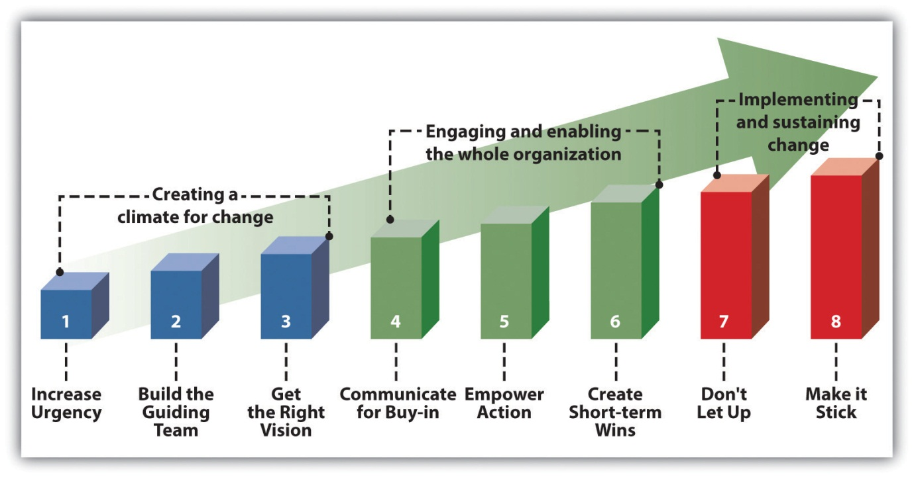
mSCOA Project Phase 4 – Change Management and Transition Strategy
The following graph represents the key components of the Change Management and Transition Strategy, which directly involves provincial treasuries and non-pilot municipalities:

Slide 4
WHAT DO WE DO?

Slide 5
mSCOA PROJECT - PROVINCE
1. PROJECT GOVERNANCE
2. PROJECT MANAGEMENT
3. PROJECT, ENGAGEMENT & COMMUNICATION PLANNING
4. COMMUNICATION FORUMS & AWARENESS TRAINING
5. ENGAGEMENTS WITH VARIOUS PROVINCIAL STAKEHOLDER GROUPS
6. RISK REGISTER(S) & ISSUE LOGS
7. AUDIT PREPARATION
7. LEARNING, KNOWLEDGE & CHANGE MANAGEMENT

Slide 6
mSCOA PROJECT - MUNICIPALITIES
1. PROJECT GOVERNANCE (Steering Committee)
2. PROJECT MANAGEMENT (Project Manager, team and plan)
3. COMMUNICATION PLANNING & ROLL OUT (Internal)
4. COMMUNICATION FORUMS, USER GROUPS & AWARENESS TRAINING
5. RISK REGISTER(S) & ISSUE LOGS (Project Documentation)
6. RE-USEABLE PROJECT SLIDES AND TEMPLATES (Terms of Reference (ToR), Charters, Project plans, Issue Logs, Risk Registers)
7. REGULAR SELF-ASSESSMENTS
8. AUDIT PREPARATION
9. LEARNING, KNOWLEDGE & CHANGE MANAGEMENT

Slide 7
WHERE SHOULD WE BE?

Slide 8
PROVINCIAL TEAMS
Set up project structures and administration/ governance
Self – and municipal assessments
Training of internal staff
External engagements: NT & Other stakeholders
Utilise pilots in province to mobilise non pilots
Mobilise municipal projects: ICF/ Information sessions, Provincial circulars, Governance structures, Project teams, Planning & risk registers
Support to municipalities:
Analyse contracts and SLAs, Development of project documentation, Review of current technology, Assist with comparing of charts, Assist with reviewing business processes and change management plans
Compilation of mSCOA compliant budgets, reports, asset registers, AFS, audit preparation
Support to municipalities affected by demarcation

Slide 9
MUNICIPALITIES
Set up project structures and administration/ governance
Documentation: Plans, charters, risk register, issue log, audit file
Internal information communication sessions
Training of project team and staff
External engagements: PT & Other stakeholders
Pre-work from circulated list and circulars - include 9 work streams,
review of 15 business processes
6. Submit high level business plan for review to PT, documentation as requested, to LG Database

Slide 10
QUESTIONS?

