Slide 1

Demystifying Standard Chart of Accounts mSCOA
One Day information session
Presented by National Treasury: Chief Directorate Local Government Budget Analysis

Slide 2
Agenda
Agenda item | Time
Registration | 08h00 to 08h30
Introduction to standard chart of accounts (mSCOA) | 08h30 to 09h15
Understanding key definitions and the accountability reforms | 09h15 to 11h00
Tea | 11h00 to 11h30
Classify, analyse and report on the economic classification using all segments of the standard chart of accounts (mSCOA) | 11h30 to 13h00
Lunch | 13h00 to 14h00
Classify, analyse and report on the economic classification using all segments of the standard chart of accounts (mSCOA) | 14h30 to 15h15
Implementation of standard chart of accounts (mSCOA) in your municipality | 15h15 to 16h00

Slide 3
Logistics and etiquette
Bathrooms and breaks.
Switch off electronic devices.
Raise your hands when you want to raise a question.
Return from breaks promptly.
Please sign the attendance register.

Slide 4
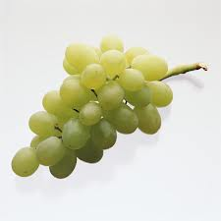
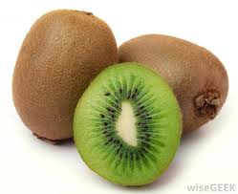
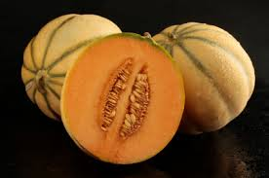



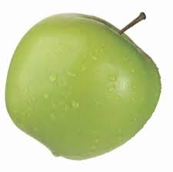
Ice-breaker
Make a fruit salad?
Ingredients
Method
You determine the method.

Slide 5
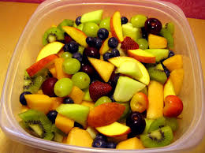
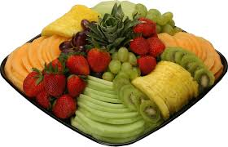
What kind of fruit salad did you make?
7 ingredients cut and placed in the bowl
I only want to eat the Kiwi Fruit.
Is there order in which you can eat the fruit?
Can you separate the good fruit from the bad?
Can this be easily achieved in the current chart?
mSCOA
Standardising the way we make and eat a fruit salad.

Slide 6
Standard Chart of Accounts for Municipalities and Municipal Entities
A distinction had to be made between the National and Provincial SCOA and the Municipal SCOA
All future references to SCOA for municipalities will be prefixed with an m - mSCOA
6

