Slide 1

Demystifying Standard Chart of Accounts (mSCOA)
Chapter 1 – Introduction to standard chart of Accounts (mSCOA)
Presented by National Treasury: Chief Directorate Local Government Budget Analysis

Slide 2
Outcomes
Explain the legislation enabling mSCOA in the local government.
Explain the purpose and objectives mSCOA for local government.
Explain the financial management reform process and the impact on mSCOA.
Discuss the roles and responsibilities of the Accounting Officer, Treasuries and mSCOA technical committee.
Explain the impact of reporting requirements has on mSCOA.
Understand what the mSCOA training is addressing.

Slide 3
The Road to mSCOA – The Budget Reform Programme
We have embarked on the long-term local government financial reform programme (Evolutionary)
  MFMA Implementation in 2003
  We have issued a suite of regulations:
  Draft Municipal Finance Misconduct Regulation (July 2012)
  Municipal Budget and Reporting Regulations (April 2009)
  Municipal Asset Transfer Regulations (August 2008)
  Municipal Regulations on Debt Disclosure (June 2007)
  Municipal Supply Chain Management Regulations (May 2005)
  Municipal Investment and PPP Regulations (April 2005)
We have developed a comprehensive budgeting system (Municipal Budget and Reporting Regulations)
We have developed a conditional grant monitoring system
Institutionalized annual engagements with the 17 non-delegated municipalities.

Slide 4
The Road to mSCOA – The Budget Reform Programme
The budget reform programme was launched in 2009 with the publication of the regulations - Government Gazette 32141 dated 17 April 2009 : Municipal Budget and Reporting Regulations
Objective
  To secure sound and sustainable management of budgeting and reporting practices of municipalities and municipal entities by establishing uniform norms and standards and other requirements for ensuring transparency, accountability and appropriate lines of responsibility in the budgeting and reporting processes of those institutions and other relevant matters as required by the Act.
Introduced standardised budgeting reporting and formats
Improved LG sphere’s ability to deliver basic services to all through:
  Improved financial sustainability
  Facilitation of medium term planning and policy choices on service delivery
Standardised reporting and formats improved
  Credibility, Sustainability, Transparency, Reliability, Relevance; and
  Comparability of budgets and in year reports of municipalities and entities

Slide 5
The Road to mSCOA - The Budget Reform Programme
Envisaged improvements
  Guided by the Constitution and the MFMA
  Promote transparency and accountability
  Strengthens the link between policy priorities, planning, budgeting, implementation and reporting
  Forms the basis for the Medium Term Revenue and Expenditure Framework for municipalities (MTREF)
  Facilitates inter-local government comparability (to demonstrate the effective use of resources and to inform allocation decisions)
  Consistent budget and reporting formats that will support GFS
  Improve golden thread of reporting - adopted budgets, in-year reporting, AFS and Annual Report

Slide 6
The Road to mSCOA – Was the budget reform enough?
Problem statement (1)
  278 different municipal ‘charts of accounts’ (COA) aggregation of budget and other information extremely difficult with inconsistent use of account labels and definitions across municipalities
  Quality of municipal information is compromised due to lack of uniform classifications for revenue and expenditure items (posting level)
  Lack of consistent information across the IDP, Budget, SDBIP, IYM and AFS
  Compromises monitoring and oversight by Councils, DCoG, treasuries and legislatures. In illustrating, 4th Quarter results – 2011/12 municipal MTREF:
    Aggregate under spending of the adjusted operating budget – R22.3 bn or 10.2%
    Aggregate under spending of the adjusted capital budget – R14,8 bn or 32.3%
    Under spending of conditional grants was R5.1 bn or 25.3%
    Can this be attributed to ineffective budgeting and financial management practices? Over ambitious expenditure appropriations; unfunded budgets; lack of credibility in reporting (S71) – pure compliance; or a mixture)
    This could further lead to incorrect decision making due to incorrectly classified transactions.
  Compromises government’s ability to formulate coherent policies affecting local government, and its ability to use the budget as a redistribution tool to address poverty and inequality
  Municipalities continuously change and amend detail COA – No consistency year-on-year

Slide 7
The Road to mSCOA – Was budget reform enough ?
Problem statement (2)
  In the absence of meaningful and credible management information municipal councils make uninformed decisions; considerable risk
  Contributing factor to weak audit opinions
  Lack of ownership by finance practitioners; inconsistency in the application of leading financial management practices corrupting the “chart”
  COA information not easily obtainable in a useful format
  Metadata not defined
  Multi-year budgeting is a relatively new concept; constant changes to the COA impedes the ability to plan over the medium-term
  Electronic budget returns and in-year reporting not aligned to the adopted budget and budget information published by municipalities

Slide 8
The Road to mSCOA
A need was identified for a standard Chart of Accounts for Municipalities and Municipal Entities
The mSCOA journey begins

Slide 9




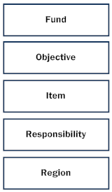
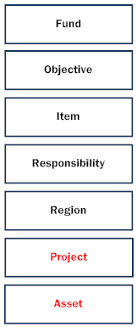

The Road to mSCOA
National and Provincial
Municipalities

Slide 10
The road to mSCOA – Legislative overview

Slide 11
The Road to mSCOA – Legal framework
Constitutional Requirements
Section 216(1) of the Constitution states that:
National legislation must establish a National Treasury and prescribe measures to ensure both transparency and expenditure control in each sphere of government, by introducing -
  Generally recognised accounting practice
  (GRAP – OAG)
  (b) Uniform expenditure classifications; and
  (Standard Chart of Accounts / General Leger)
  (c) Uniform treasury norms and standards
    (MFMA, Regulations, Circulars and Guidelines)

Slide 12
The Road to mSCOA – Legal framework
MFMA Requirements
Section 168 (1) of the MFMA states that:
The Minister (of Finance), acting with the concurrence of the Cabinet member responsible for local government, may make regulations for, among other things –
  any matter that may be prescribed …and…
  (p) any other matter that may facilitate the enforcement and administration of the Act

Slide 13
The Road to mSCOA – The Regulations
Local Government: Municipal Finance Management Act (56/2003): Municipal Regulations on Standard Chart of Accounts (Gazette No. 37577)
  Key Objectives in preamble
    improved data quality and credibility;
    the achievement of a greater level of standardisation;
    the development of uniform data sets critical for 'whole-of-government‘ reporting;
    the standardisation and alignment of the 'local government accountability cycle' by the regulation of not only the budget and in-year reporting formats but also the annual report and annual financial statement formats;
    the creation of the opportunity to standardise key business processes with the consequential introduction of further consistency in the management of municipal finances;
    improved transparency, accountability and governance through uniform recording of transactions at posting account level detail;
    enabling deeper data analysis and sector comparisons to improve financial performance; and
    the standardisation of the account classification to facilitate mobility in financial skills within local government and between local government and other spheres as well as the private sector and to enhance the ability of local government to attract and retain skilled personnel.

Slide 14
The Road to mSCOA – The Regulations
Object of the regulations
  to provide for a national standard for the uniform recording and classification of municipal budget and financial information at a transaction level by prescribing a standard chart of accounts for municipalities and municipal entities which
    are aligned to the budget formats and accounting standards prescribed for municipalities and municipal entities and with the standard charts of accounts for national and provincial government; and
    enable uniform information sets recorded in terms of national norms and standards across the whole of government for the purposes of national policy coordination and reporting, benchmarking and performance measurement in the local government sphere

Slide 15
The Road to mSCOA – The Regulations
The regulations apply to all municipalities and municipal entities
  For municipal entities the reporting in annual financial statements and annual reports may differ due to commercial nature of some of the municipal entities.
  There is no exemption from the regulation for the application of mSCOA to municipal entities.
Chapter 2
  Segments and classification framework for standard chart of accounts
    7 Segments
  Implementation requirements
    7 Segments
    must accurately record all financial transactions and data in the applicable segment.
    may not contain data which is mapped or extrapolated or which otherwise does not reflect transactions recorded or measured by the municipality or municipal entity
    Financial and business application
      hosting of the general ledger structure
      capable of accommodating and operating mSCOA
      portal allowing for free access, for information purposes, to the general ledger of the municipality or municipal entity, by any person authorised by the Director-General or the Accounting officer of the municipality

Slide 16
The Road to mSCOA – The Regulations
Chapter 3
  Minimum business process and system requirements
    These are still to be published
Chapter 4
  Technical committee for standard chart of accounts
    Composition of committee
    Function of mSCOA committee
Chapter 5
  Responsibilities of municipal functionaries
    Responsibilities of municipal councils and board of directors
    Responsibilities of accounting officers
Chapter 6
  General
    Access by National Treasury
    Postponement of implementation and exemption

Slide 17

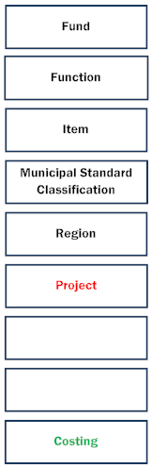
The Road to mSCOA
National and Provincial
Municipalities

Slide 18
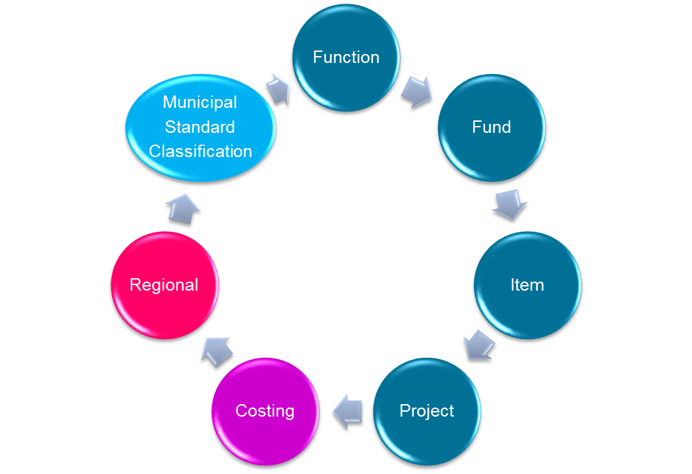
The Road to mSCOA – The Chart

Slide 19
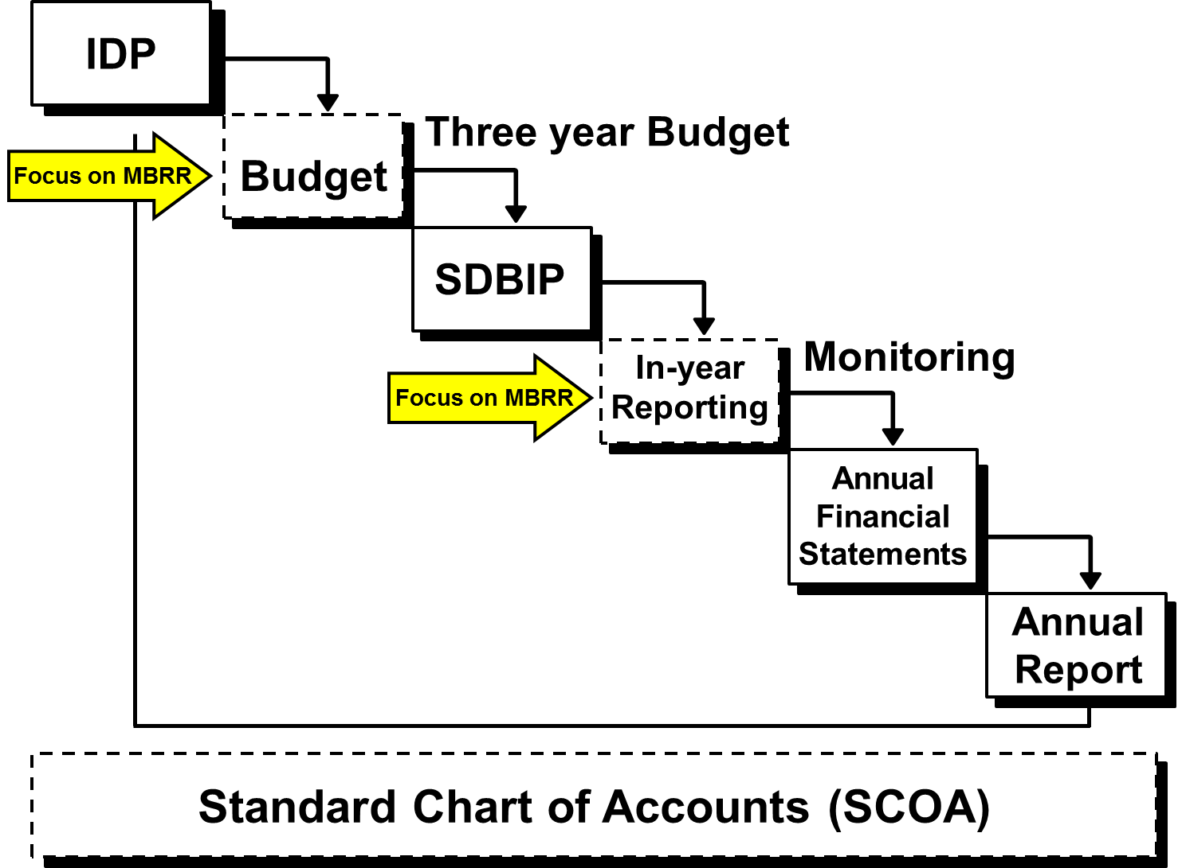
Financial Reforms - Municipal Accountability Cycle
NDP
MTSF

Slide 20
Understanding mSCOA
Detailed Classification System
  Not GFS, GRAP or Budget Formats but classification system (Posting Level Detail) = mSCOA
  Provide sufficient detail for reporting through combining/selecting from segment detail into reporting formats prescribed by recognised stakeholders
  Reporting Formats – Provides report writer within financial systems application or stakeholder databases
What does this mean?
  Provide for detail to be added by municipalities
  Clearly defined account labels (Metadata)
  Accounts to be standardised for all Munics/ME/Agencies
  Comprehensive “Design Principles” for segments and account groups
  “Grid” to select what is applicable to the municipality

Slide 21
Overall Design Principles for mSCOA
Classification framework limited to financial information
International standards, guidance and best practices
Comply with legislative framework for local government
Labels and accounts to be clearly defined
Comprehensive framework (grid) to satisfy stakeholders needs
Information to be easily extracted
Alignment of financial and budget reporting formats
Integration of GRAP standards
Standardisation of terminology
Standardisation of transaction classification
Reporting on “whole-of-local government and government”
Simple classification
Financial system integration with optimised business and programme rules
Notes:
The development of this framework must give recognition to:
a. international standards, guidance and best practices;
b. labels and accounts defined to have readily available the information needed for local government budgeting (annual budgets, adjustment budgets and SDBIP) and reporting (monthly, mid-year performance assessment and annual financial statements);
c. general alignment of financial reporting formats and the annual financial statements to key budget format reforms;
d. alignment of budget and reporting formats with Generally Recognised Accounting Practice (GRAP) and principles within the provisions of the transitional arrangements applicable to the different categories of municipality, especially recognising that local government uniquely operates in an accrual accounting and accrual budgeting environment;
e. consistent use of terminology across all municipality by defining all accounts and labels in simple terms to support appropriate classification of transactions throughout all municipalities;
f. standardisation across local government clearly outlining the information requirements will enable municipalities and their information system suppliers to develop software and report writing formats that are automated and complaint to reporting requirements;
g. reporting on the “whole-of-local government”, and thus contribute to “whole-of-government” monitoring and evaluation;
h. finding a solution for the separation of the general government sector, which “consists of entities that fulfil the functions of government as their primary activity” and business activities that sell services at market prices within a local government environment, especially where the management of these functions tend to be closely interrelated with general government
activities;
minimising the cost of compliance and information gathering; and
j. the classification framework must be kept simple and avoid unnecessary complexities to the maximum extent possible, all within the context of other objectives.
The SCOA will be applicable to all Municipalities, Municipal Entities and “Utilities” clearly indicating their applicability and relevance to a specific environment to assist customisation.
The improved quality of data will enhance the budget, financial reporting and other decision making processes having an impact on local government. The classification framework will be formalised by issuing a SCOA Regulation in terms of the Municipal Financial Management Act.

Slide 22
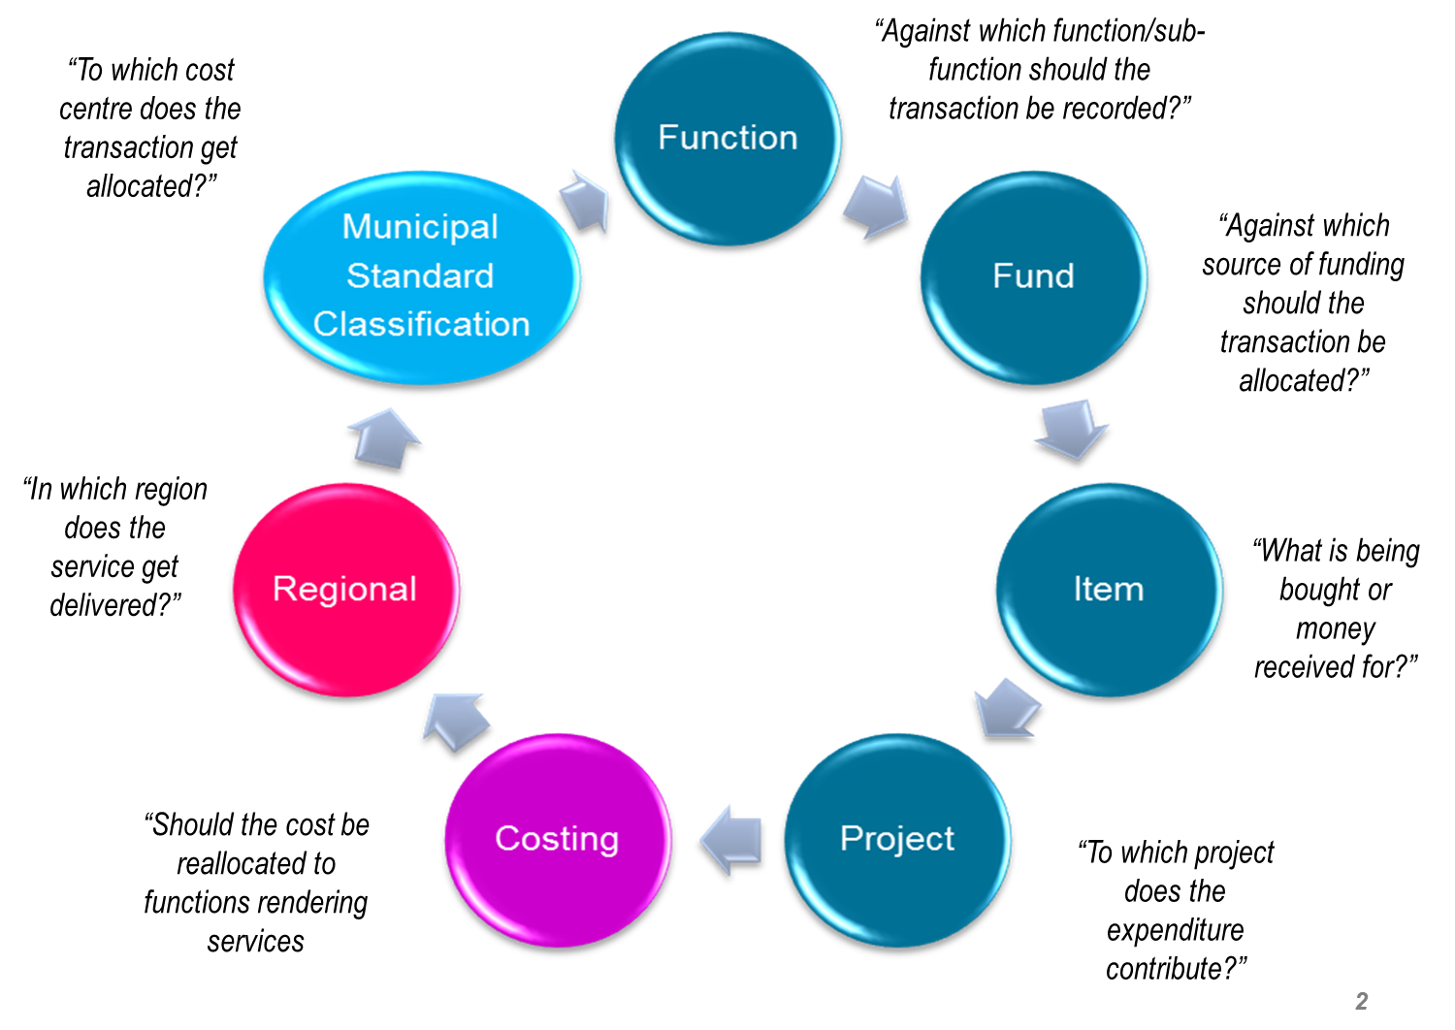
Segments of SCOA for Municipalities
22

Slide 23
Roles and responsibilities – mSCOA Technical committee
must review the classification framework and, where required, make recommendations to the Minister on amendments to that framework;
must develop guidelines and training material that are aligned to the classification framework.
must review the implementation of the standard chart of accounts in government as a whole to ensure the alignment of the standard chart of accounts provided for in the Regulations and the standard chart of accounts applicable in national and provincial government;
when required to align the mSCOA regulations with changes to other legislation applicable to local government, must make recommendations to the Minister on amendments to the mSCOA regulations;
must undertake such other functions relating to the implementation the regulations

Slide 24
Roles and responsibilities – National Treasury
    mSCOA Project Sponsor on behalf of the National Treasury.
    mSCOA Project Management leading up to 1 July 2017.
    Core mSCOA Project Team for mSCOA Project Phase 4 (Change Management and Training).
    Assisting municipalities with budget implementation aligned to the mSCOA classification framework.
    Administrator and owner of the Local Government Data Base and related reporting system (LGDBRS)
    Benchmarking and budget oversight responsibility.
    Overall stakeholder management (Internal and external)
    Custodian of ensuring mSCOA is in compliance with relevant municipal legislative framework and associated norms and standards.
    Linkage of National and Provincial SCOA to mSCOA.
    Responsible for the development, implementation and maintenance of the classification framework for all 3 spheres of government.

Slide 25
Roles and responsibilities – Provincial Treasuries
    Key role player in the change management and communication process.
    Oversee the implementation of mSCOA by all municipalities within the province with the aim of full compliance by 1 July 2017.
    Assist National Treasury in the risk management process.
    Engage with all municipalities and share information, resolve queries and provide guidance with implementation.
    Logistical arrangements as it relates to provincial workshops, training sessions and engagements.

Slide 26
Roles and responsibilities – other external role players
  AUDITOR GENERAL
    Audit municipalities within the Constitutional Mandate.
    Develop and inform production champions and auditors responsible for municipalities as to the content and classification framework inherent to mSCOA.
    Participate by sharing views, concerns and possible areas of non-compliance with the Office of the Accountant-General
  REGULATORS / STAKEHOLDER DEPARTMENTS
    Active participation in the development of mSCOA.
    Responsible for enforcing compliance to mSCOA as it relates to their mandate.
    Support National Treasury in “training and change management process”.
  SYSTEM VENDORS
    Development of system functionality (financial application) in support of the mSCOA classification framework, business rules, and reporting requirements at a transactional level.
    Actively contribute to the change management and awareness process.
    Active participation in the development process

Slide 27
Roles and responsibilities – Within the Municipality
  MUNICIPAL COUNCIL
    Governance, oversight over municipalities implementation of mSCOA and managing risk inherent
  ACCOUNTING OFFICER
    Ultimately responsible for controls, administration and reporting in terms of the Municipal Finance Management Act.
    Responsible for adherence and compliance to all legislation and regulations governing the municipality.
    Involvement of Internal Audit and Risk Manager.
    Delegating the necessary powers and duties to the appropriate officials.
    Ensuring that the responsible officials have the necessary capacity by providing training and ensuring that they attend training or workshops provided by National Treasury.
    Ensuring that the financial and business applications of the municipality or municipal entity have the capacity to accommodate the implementation of these Regulations and that the required modifications or upgrades are implemented

Slide 28
Roles and responsibilities – Within the Municipality
  ACCOUNTING OFFICER
    submitting reports and recommendations to the municipal council or the board of directors, as the case may be, that provide for the adoption of any resolutions, policies and budgetary provisions necessary for the implementation of the Regulations.
    Identification of Project Manager, Project Office and development of Project Plan guiding the municipality with implementation
    Oversight of progress with SCOA implementation.
    Internal change management agent

Slide 29
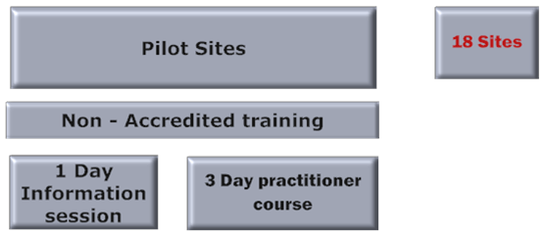
National Treasury Training initiatives
18 Nov to 9 Dec 2014
March to April 2015

Slide 30
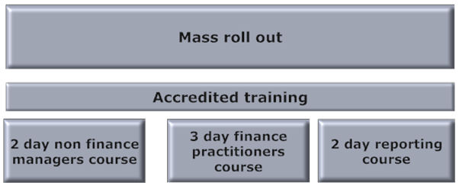
National Treasury Training initiatives
July 2015 onwards

Slide 31
Questions

