Slide 1

Demystifying Standard Chart of Accounts (mSCOA) Chapter 2 – Key definitions and understanding the accountability reforms
Presented by National Treasury: Chief Directorate Local Government Budget Analysis

Slide 2
Outcomes
Explain the background and components within the municipal accountability cycle.
Categorise revenue in accordance with reporting formats.
Categorise expenditure (capital and operational) in accordance with the reporting formats.
Have a general understanding of VAT in the municipal environment.
Explain the outcome of non cash transactions and other transactions in “assets, liabilities and net assets” within the mSCOA classification.

Slide 3
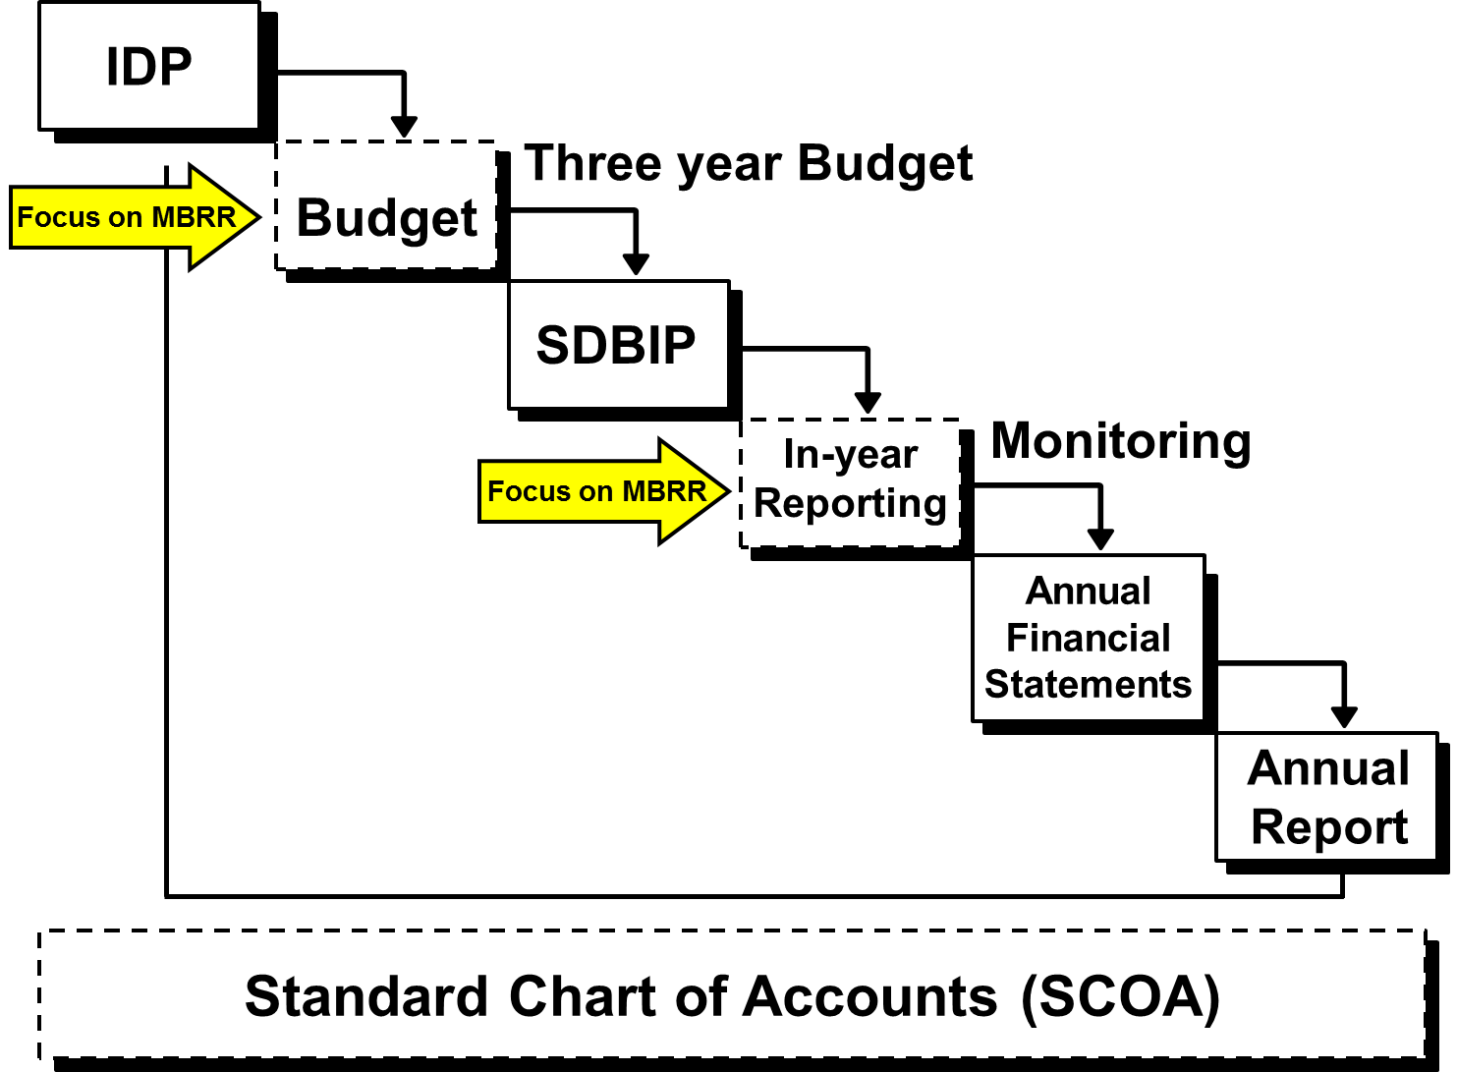
Financial Reforms - Municipal Accountability Cycle
NDP
MTSF

Slide 4
Financial Reforms - Municipal Accountability Cycle
NDP – National Development Plan
MTSF – Medium Term Strategic Framework
Integrated development plans (IDP)
This sets out the goals and development plans, which need to be aligned with the municipality's available resources. Council adopts the IDP and undertakes an annual review and assessment of performance based on the annual report.
Budget
The three year budget sets out the revenue raising and expenditure plan for the municipality for approval by council. The allocation of funds needs to be aligned with the priorities in the IDP.
Service delivery and budget implementation plan (SDBIP)
Sets out monthly and quarterly service delivery and financial targets aligned with the annual targets set in the IDP and budget. It lays the basis for the performance agreements of the municipal manager and senior management.
In year reports
The administration reports to council on the implementation of the budget and SDBIP through monthly, quarterly and mid year reports. Council uses these reports to monitor both the financial and service delivery performance of the municipality's implementation actions.

Slide 5
Financial Reforms - Municipal Accountability Cycle
Annual financial statements
Reports on the implementation of the budget, and reflect the financial position of the municipality. They are submitted to the Auditor General, who issues an audit report indicating the reliance council can place on the statements in exercising oversight.
Annual Report
It is the primary instrument of accountability, in which the mayor and municipal manager report on the implementation performance in relation to the budget and the SDBIP, and the progress being made in realising the IDP priorities.
Oversight report
Council produces an oversight report based on outcomes highlighted in the annual report and actual performance.

Slide 6
Budget process timelines – 2015/2016 – Pilot municipalities

Slide 7
Budget process timelines
Non pilot municipalities/municipal entities must prepare an mSCOA aligned budget to be adopted by 30 June 2017.
What are the implications of the above for you ?
Refer to implementation of mSCOA in your municipality – last presentation

Slide 8
Purpose of reports from the accountability cycle
The main purpose of the reports as stated in the accountability cycle is to provide information about sources of revenue and use of funds.
Broadly, the main purpose of whole of government operations is to use public resources to:
regulate relevant aspects of society and the economy
provide services to the community in areas where there is market failure
build, improve and maintain infrastructure
redistribute wealth according to nationally determined criteria.
To fulfil these functions effectively, whole of government must raise revenue and it must spend, and the reports (from the accountability cycle) provides the analytical presentation of local government revenue and expenditure.

Slide 9
Budget tables – Revenue by source

Slide 10
SDBIP – Revenue by source

Slide 11
Categorise revenue in accordance with reporting formats – S71 report

Slide 12
Annual Financial Statements – Revenue by source

Slide 13
Budget tables – expenditure (Operational)

Slide 14
Categorise expenditure in accordance with reporting formats – S71 report

Slide 15
Annual Financial Statements – Expenditure - operational

Slide 16
Budget tables – expenditure (capital)

Slide 17
Annual Financial Statements – Financial position- Capital

Slide 18
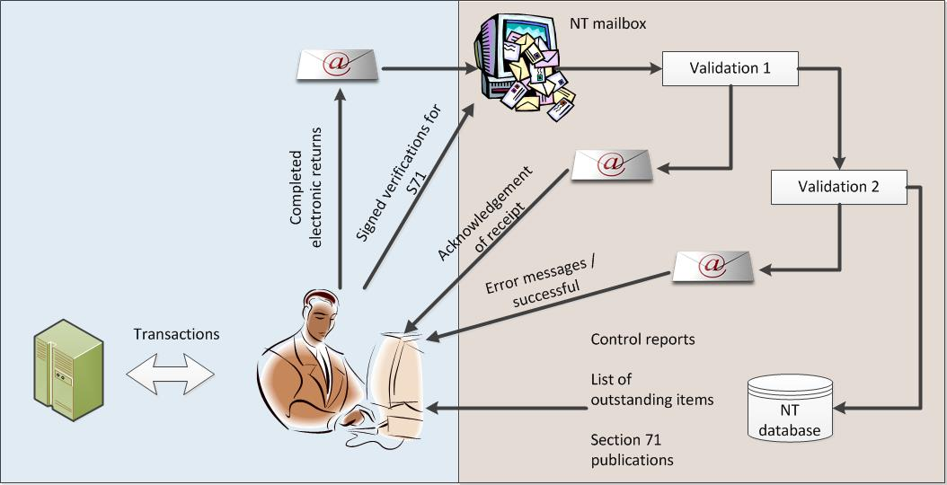
Current collection method and processes

Slide 19
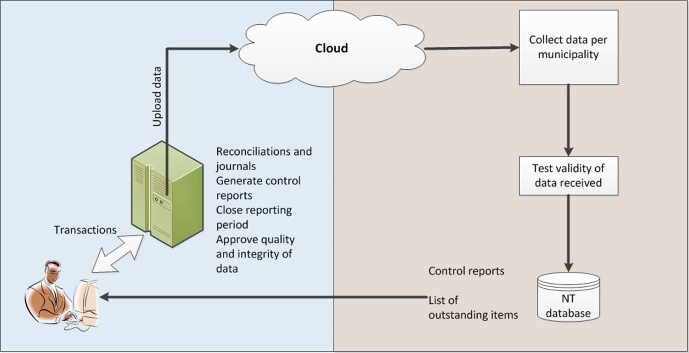
Intended collection method and processes

Slide 20
Key points in respect to change to data collection
The current reporting processes concentrate on people with the financial system as a side issue which can easily be ignored / used / abused.
The new collection method will place the emphasis where is should be - the centralised financial system. This will ensure that reporting on budgets / in-year results / AFS is always aligned.
The current process requires a lot of intervention from NT to ensure integrity and quality of data.
With the implementation of mSCOA all quality checks and control reports will be generated in the municipality.
NT is currently researching methods and technologies for the most effective collection of information being reported by municipalities.
Non-piloting municipalities will continue to report using the current processes to ensure continued S71 publications.
Piloting municipalities will start to use the new reporting method BUT must be able to fall back onto the old method if any problems or connectivity issues are experienced.
NT will cater for both reporting methods until most municipalities have implemented mSCOA successfully.

Slide 21
Revenue
What is revenue
The gross inflow of economic benefits or service potential during the reporting period when those inflows result in an increase in net assets, other than increases relating to contributions from owners.
2 Categories of revenue
Exchange
Non-exchange
3 broad sources
Tax revenue
Transfers
Municipal activities

Slide 22
Revenue

Slide 23
Revenue - Key definitions
Exchange transactions
Are transactions in which one entity receives assets or service, or has liabilities extinguished, and directly gives approximately equal value (primarily in the form of cash, goods, services or use of assets) to another entity in exchange
Non exchange transactions
The municipality either receives value from another entity without directly giving approximately equal value in exchange or gives value to another entity without directly receiving approximately equal value in exchange.
Contra Accounts - Revenue
Covers all rates rebates, exemption and discounts given to households and other customer groups either in general or specifically. Covers all free services or service discounts given in relation to services for which the municipality normally charges. Must not include the cost of debt write offs.

Slide 24
Revenue – Rules to remember
Tax receipts
Non exchange
Outside of the courts
Complying with law
Fees charged > cost
Fines, Forfeits, Penalties
Non exchange
Imposed by the court
Contravention of law
Fees not related to costs
Sale of goods and services
Exchange
Individual’s choice
Regulation/ Administration
Fees charged = cost recovery
Rates
Traffic Fine
Registration fee

Slide 25
Revenue – An example
In the City of Cape Town , Mrs. Cole receives R100 from Mr. Xang in respect to sale of tender documents. Mrs Cole prepares a receipt to be handed to Mr. Xang.
How would you classify this revenue transaction?

Slide 26
Revenue – An example

Slide 27
Revenue – The solution
mSCOA item - Exchange Revenue: Sales of Goods and Rendering of Services –
Sale of Goods: Publications - Tender Documents

Slide 28
Expenditure
What is expenditure
Expenses are decreases in economic benefits or service potential during the reporting period in form of outflows or consumption of assets or incurrence’s of liabilities that result in decreases in net assets, other than those relating to distributions to owners.
2 main categories of expenditure
Operational
Capital

Slide 29
Expenditure - Operational

Slide 30
Key definitions – Expenditure (operational)
Contra accounts - expenses
Revenue forgone is reflected as “income” on the revenue side and “expenditure” on the expenditure side.
Depreciation and amortisation
Depreciation is the systematic allocation of the cost of an asset from the Statement of Financial Position to Depreciation Expense on the Statement of Financial Performance over the useful life of the asset. Amortisation is the systematic allocation of the discount, premium or issue cost of a financial instrument over the life of the instrument, or an intangible asset over a certain period. Amortisation is the systematic allocation of the depreciable amount of an intangible asset over its useful life.
Operational Costs
An operating expense is a day-to-day expense such as sales and administration, or research & development, accounting expenses, license fees, advertising, office expenses, utilities such as telephone, insurance, property management, travel and vehicle expenses.
Transfers and subsidies
Unrequited payments made by the municipality. Unrequited has the same meaning as non exchange transaction, however transfers and subsidies refers to payments being made. It includes both current and capital transfers.

Slide 31
Expenditure (Operational) – An example
Mrs Khumalo is a municipal manager in municipality Y. She has an invoice from ABS Consulting Services (Pty) Ltd for the sum of R125,350. The invoice was for a consulting firm conducting an empowerment exercise relating to the internal audit function at the municipality.
How would you classify this expenditure transaction?

Slide 32
Expenditure - Operational

Slide 33
Expenditure – Operational - Solution
mSCOA Allocation: Expenditure: Contracted Services - Outsourced Services: Business and Advisory - Organisational

Slide 34
Expenditure – Capital

Slide 35
Expenditure – Capital – net assets

Slide 36
Key definitions
Assets
Assets are resources controlled by the municipality as a result of past events and from which future economic benefits or service potential are expected to flow to the municipality.
Current Assets
Refers to assets which would recover in no more than 12 months after the reporting date or if the normal operating cycle is more than 12 months the longer period.
Net Assets
Retained earnings or accumulated deficit being the cumulative effect of differences between assets and liabilities as per statement of financial position.
Non-current assets
Refers to assets which would recover after 12 months or after the normal operating cycle of the municipality

Slide 37
Key definitions
Receivables from Non-exchange Transactions
This account is used for recording amounts receivable due from non-exchange transactions, such as insurance claims, rates and other taxes, subsidies, road reinstatements, repayments resulting from unauthorised expenditure.
Trade and Other Receivables from Exchange Transactions
A current asset resulting from selling goods or services on credit (on account) such as water, electricity
Property, Plant and Equipment
A major classification on the statement of financial position. Included are land, buildings, leasehold improvements, equipment, furniture, fixtures, delivery trucks, automobiles, etc. A distinction is made between "owned assets" and assets subjected to financial leases labelled as "leased assets".

Slide 38
Expenditure (Capital ) – An example
Mrs Hendriks is a municipal official responsible for capital spending. She authorises an invoices to be paid for the purchase of a office furniture for the value of R 228,000.
How would you classify this expenditure transaction?

Slide 39
Expenditure – (Capital) - An example

Slide 40
Expenditure – (Capital) - Solution
mSCOA allocation : Non-current Assets: Property, Plant and Equipment - Owned: Cost - Furniture and Office Equipment: All or excl NERSA - Acquisitions

Slide 41
VAT in municipalities
SARS have issued VAT guide 419 on the 30 March 2011.
mSCOA does not change the way the municipality accounts for VAT.
Within the classification system you budget for VAT as you account for it.
System vendors will need to configure the systems to deal with the following type of VAT transactions.

Slide 42
Non cash transactions
The municipality has many non cash transactions for example
Depreciation
Free services – contra accounts
Gains
Losses
These will be dealt with during the training of financial management practitioners, we focus on some of the key definitions.

Slide 43
Non cash transactions - Key definitions
Gains
represent other items that meet the definition of revenue and may, or may not arise in the course of the operating activities of the municipality. Gains represent increases in economic benefits or service potential and as such are no different in nature from revenue.
Losses
represent other items that meet the definition of expenses and may, or may not, arise in the course of the operating activities of the entity. Losses represent decreases in economic benefits or service potential and as such, they are no different in nature from other expenses.

Slide 44

Questions

