Slide 1

mSCOA ICF Financial applications and progress in hosting the classification framework – System functionality
Presented by National Treasury: Chief Directorate Local Government Budget Analysis | 22 June 2015

Slide 2
Legislative (Bolding for emphasis only)
Municipal Systems Act, No. 32 of 2000
“Adoption of integrated development plans
25. (1) Each municipal council must, within a prescribed period after the start of its elected term, adopt a single, inclusive and strategic plan for the development of the municipality which:
links, integrates and co-ordinates plans and takes into account proposals for the development of the municipality;
aligns the resources and capacity of the municipality with the implementation of the plan;
forms the policy framework and general basis on which annual budgets must be based;”
Municipal Finance Management Act, No 56 of 2003.
“Budget preparation process
21. (1) The mayor of a municipality must – (a) co-ordinate the processes for preparing the annual budget and for reviewing the municipality’s integrated development plan and budget-related policies to ensure that the tabled budget and any revisions of the integrated development plan and budget-related policies are mutually consistent and credible;”
Municipal Regulations on Standard Chart of Accounts Gazette No 37577
“Object of these Regulations
2. The object of these Regulations is to provide for a national standard for the uniform recording and classification of municipal budget and financial information at a transaction level by prescribing a standard chart of accounts for municipalities and municipal entities which
(a) are aligned to the budget formats and accounting standards prescribed for municipalities and municipal entities and with the standard charts of accounts for national and provincial government; and
(b) enable uniform information sets recorded in terms of national norms and standards across the whole of government for the purposes of national policy coordination and reporting, benchmarking and performance measurement in the local government sphere.”

Slide 3
What do this mean?
The regulation and legislation consequently drives municipalities to achieve their IDP alignment.
Targeting Financial transactions and Budgets at a transactional level to be mutually consistent and credible.
It introduce elements of non financial reporting.
Informed the assessments at a core level.

Slide 4
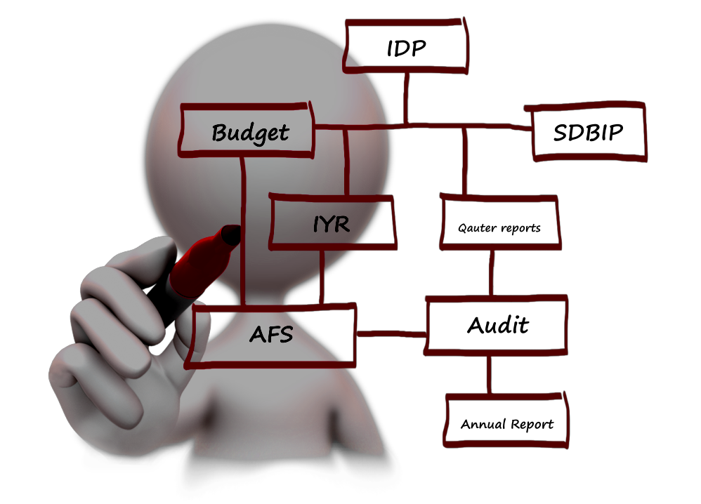
Accountability Cycle as it is currently executed.

Slide 5
Local Government Accountability Cycle & mSCOA
Standard Chart of Accounts
Improved Service Delivery
The integrated development plan (unlimited needs and wants) must directly inform the formulation of the budget (limited basket of resources). In a mSCOA perspective, this requires budget formulation (as per the MBRR) from a project level. Consequently the Project Segment is consider the departure point in formulating budgets across all seven segments.
IDP
Budget
SDBIP
IYR
AFS
Annual Report
5 Year Strategy
3 Year Budget
Annual Plan to Implement
Monitoring
Oversight
Budget, implementation (transacting) and reporting
MBRR and reporting to LG Database (all 7 segments)
Formulation of implementation plan such as regional perspective, funding, cash flow breakdown etc.
In-year reporting (focus MBRR), Section 71 & 72
Budgeting to directly inform implementation and transactional environment
Seamless alignment
One version of the truth
Evidence based financial management in real time
Transactional validation and audit trails
mSCOA provides for alignment of the accountability cycle;
Improved transparency and accountability;
Classification based on leading practice and internal standards;
Consistent aggregation of municipal financial info across the entire accountability cycle
Whole of government reporting
Accountability Reporting
Incorporation of GRAP
Improved standardisation
Improved audit process across 278
Consistent comparability
Transparency

Slide 6
General Approaches Taken
Pros
Cons
The objectives of the regulations is achieved
The IDP is fully aligned and budgeted for depending on availability of funding. Tariffs are consequently reflective of costs.
The whole institution participated in the reform.
The whole accounting environment changed.
The cost implication and associated risks are massive but seems mitigated with UAT (user acceptance testing). The transactional environment is new and change control would be required intensively
Accounting Cycle
Movement towards full compliance
Capital, maintenance and certain campaigns are driven from projects and the systems therefore has functionality. The budgets seems to be credible as it is funded and tariffs considered costing form non commercial departments.
Virement’ s probable
The budget due to various interpretations and the impact that the segments string has if budgeted from a Item perspective may have missed implication such as funding links. This will create an inability for comparative reporting across all segments and they will need to adjust for the next budget to full projects creating additional effort in time and cost of implementation.
Hybrid
The end users and system look and feel remained stable.
End users in the transactional environment will not be affected except for the volume of new votes.
Minimum compliance.
The approach while risk adverse creates the highest and acknowledged virement probability. Budgets therefore might be viewed as unreliable and consequently impact adversely on the audit outcomes. Depending on the level and quantum of required segments they probably will fail measurement or benchmarking against the other approaches.
Short Code

Slide 7
Summary
Number of Muncipalities
Position
1.
Projects
Pilots = 8
Total Municipalities = 94
The municipalities will have the immediate and most difficult time during the piloting.
The vendors will understand and consequently upscale their support at the clients to achieve the deadline.
2.
Pilots = 7
Total Municipalities = 68
The approach will have probable difficulties as far as operational projects is concerned and as such the vendors will need to adopt more projects and integrate the project/ jobbing modules into an IDP driven approach for the next budgets.
Hybrid
3.
Short code
Pilots = 5
Total Municipalities = 108
We are reasonably worried about the excessive virement that would result continuously from this approach . If not carefully managed this may even be viewed as mapping. The accounting cycle is not achieved here.
4.
SAP(3), Oracle(1)
BCX(3)
MICROmega(1).
Position on Metro’s not made.
Metro’s

Slide 8
Pilots Visits – Self Assessment and Operational Functionality
Municipalities / Metro's | Proposed dates
Hessequa Local Municipality | 29-Jun
Knysna Local Municipality | 30-Jun
Camdeboo Local Municipality | 01-Jul
Senqu Local Municipality | 02-Jul
Mangahung Metro | 03-Jul
Sol Plaatjie Local Municipality | 03-Jul
Polokwane Local Municipality | 08-Jul
Musina Local Municipality | 08-Jul
Greater Giyani Local Municipality | 09-Jul
Elias Motsoaledi Local Municipality | 10-Jul
Ethekwini Metro | 15-Jul
uMgungundlovu District Municipality | 16-Jul
Richmond Local Municipality | 16-Jul
uMhlathuze Local Municipality | 17-Jul
Victor Khanye Local Municipality | 20-Jul
Municipalities / Metro's | Proposed dates
Nkangala District Municipality | 20-Jul
Ekurhuleni Metro | 21-Jul
Tlokwe Local Municipality | 21-Jul
Nala Local Municipality | 22-Jul
Setsoto Local Municipality | 23-Jul
Overstrand Local Municipality | 27-Jul
Drakenstein Local Municipality | 28-Jul
Bergrivier Local Municipality | 29-Jul
City of Cape Town Metro | 31-Jul
City of Johannesburg Metro | 7-Aug
City of Tshwane Metro | 11-Aug
Port Elisabeth Metro | 12-Aug
Buffalo City Metro | 13-Aug
Mossel bay Local Municipality | 14-Aug

Slide 9
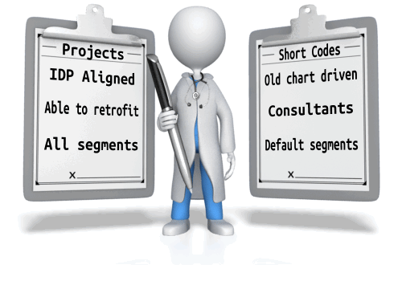
Questions?

Slide 10
THANK YOU

