Slide 1

mSCOA ICF
Financial Statistics and Local Government Database
Presented by National Treasury: Elsabé Rossouw – 22 June 2015
Notes:
1

Slide 2
Background and definitions
DEFINITION of 'Statistics‘
A type of mathematical analysis involving the use of quantified representations, models and summaries for a given set of empirical data or real world observations. Statistical analysis involves the process of collecting and analysing data and then summarizing the data into a numerical form.
Statistics is a general term used to summarise a process that an analyst, mathematician or statistician can use to characterize a data set. If the data set is based on a sample of a larger population, then the analyst can extend inferences onto the population based on the statistical results from the sample.
http://www.investopedia.com/terms/s/statistics.asp

Slide 3
Background and definitions
According to the IMF manual issued in 2000, monetary statistics consist of a comprehensive set of stock and flow data on the financial and nonfinancial assets and liabilities of an economy’s financial corporations sector. The organization and presentation of monetary statistics follow a hierarchical approach based on two general data frameworks -
The first and most basic framework is the sectoral balance sheet, which contains the highly disaggregated stock and flow data for all categories of assets and liabilities of an individual subsector within the financial corporations sector.
The second framework is the survey, in which the data from the sectoral balance sheets of one or more of the financial corporation’s subsectors are combined into more aggregated asset and liability categories that are particularly useful for analytical purposes.

Slide 4
Background and definitions
Financial statistics consist of a comprehensive set of stock and flow data on the financial assets and liabilities of all sectors of an economy. The financial statistics are organized and presented in formats designed to show financial flows among the sectors of an economy and corresponding financial asset and liability positions.
In order to find common ground for financial statistics, the following elements must be considered:
Common definitions and classifications
Well defined reporting framework and prescribed periods of reporting
Alignment of said definitions and reporting framework between the sectors to be considered for consolidated statistics.
Well-designed mechanisms for the collection of surveys and supporting systems for the analysis, consolidation and sharing of data and analysis reports.

Slide 5
CURRENT FINANCIAL STATISTICS REPORTING
National and provincial sphere
BAS is the core of government accounting systems; it is the General Ledger where all transactions are recorded and classified in accordance with the principles of the Standard Chart of Accounts and is the main source of information for the preparation of management reports and the annual financial statement. Transaction processing originates in sub-systems before they are “captured” in the general ledger. An important internal control measure is to reconcile information in the sub-systems to BAS to ensure that transactions processed in the sub-systems are captured correctly in BAS.
There are various sub-systems where expenditure is transacted: PERSAL (payroll system), LOGIS (inventory and asset management), MEDSAS (pharmaceuticals – health sector), Debit orders (payment of utilities).

Slide 6
CURRENT FINANCIAL STATISTICS REPORTING
Local government
The National Treasury (NT) is amongst others responsible for ensuring that the local government sector operates within the fiscal policy framework of Government. To perform this function, municipal budgets, financial performance, i.e. actual revenues and expenditure, financial position, i.e. assets and liabilities and municipal performance on service delivery must be monitored.
Reforms to date:
  Local Government Database and Reporting System (LGDRS)
  Municipal Budget and Reporting Regulations (MBRR)
  Local Government Standards chart of accounts (mSCOA)

Slide 7
CURRENT FINANCIAL STATISTICS REPORTING
LGDRS is used by
NT:LGBA for the financial oversight of all municipalities
PTs: for the financial oversight of provincial delegated municipalities
External stakeholders: StatsSA, SARB, DPME, DoCG, SALGA
Universities and researchers
Other sectoral departments
It is fully mobile and accessible through secure internet.
Security profiles restrict access to all data.

Slide 8
CURRENT FINANCIAL STATISTICS REPORTING
Reports available to users can be broadly divided into four groups:
  Reports on the administrative processes;
  Reports on information submitted per municipality;
  Analysis of financial information; and
  Publication reports
For each municipality the database stores information on:
  Tabled, adopted and adjusted budgets; Conditional grant expenditure;
  Monthly financial performance; Capital acquisition;
  Cash flow; Balance sheet information;
  Creditor age analysis; Debtor age analysis;
  Asset management; Borrowing and investment instruments;
  Expenditure on repairs and maintenance and audited results.
  ;

Slide 9
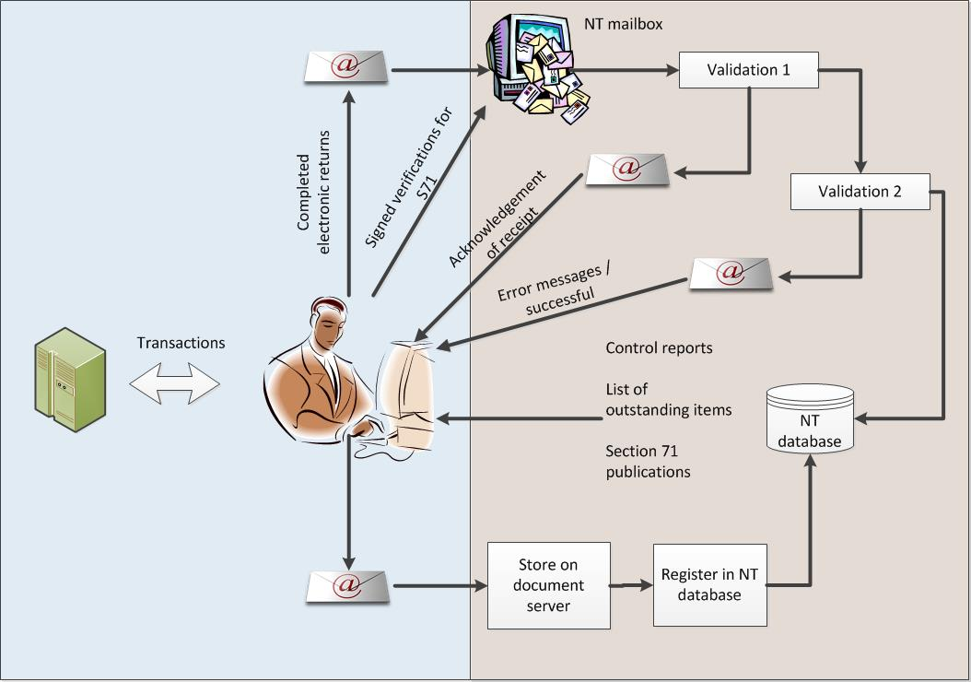
Current collection and processing method

Slide 10
Products of the current LGDRS
1. Budget publications
  MTREF verified results over 7-year horizon
  Tabling dates of municipalities;
2. Quarterly in-year publications;
3. End of financial year analysis
  Over and under spending
  State of municipal finances;
4. Biennial Local Government and Expenditure Review;
5. Centralised document server for all legal documents required from municipalities;
5. Spatial representation of financial data; and
6. BI Portal based on Section 71 quarterly published figures.

Slide 11
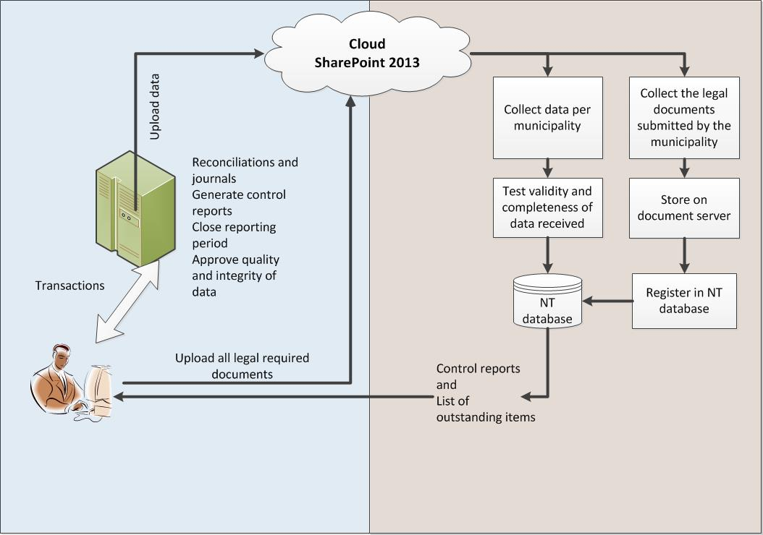
Proposed collection method for the new LGDRS

Slide 12
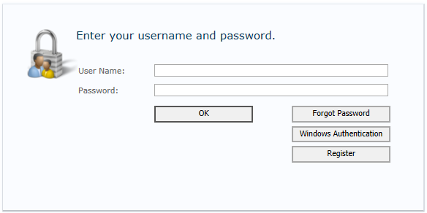
Login with your unique user id and password

Slide 13
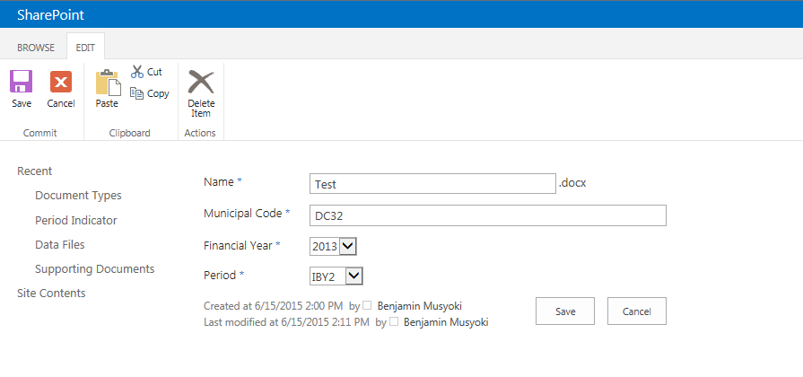
Pipe delimited financial batch files

Slide 14
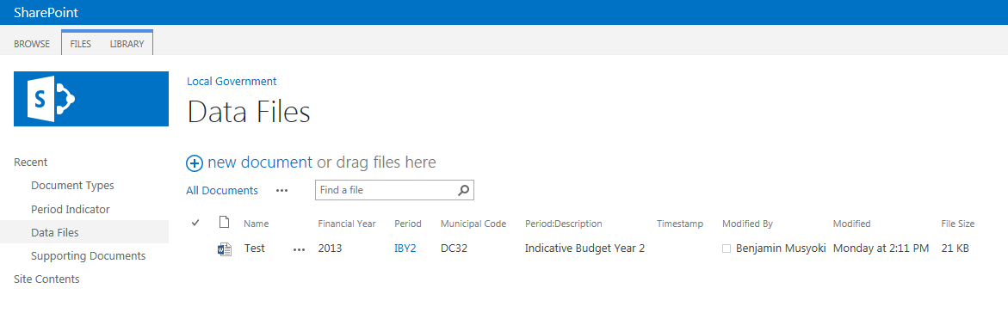
Pipe delimited financial batch files

Slide 15
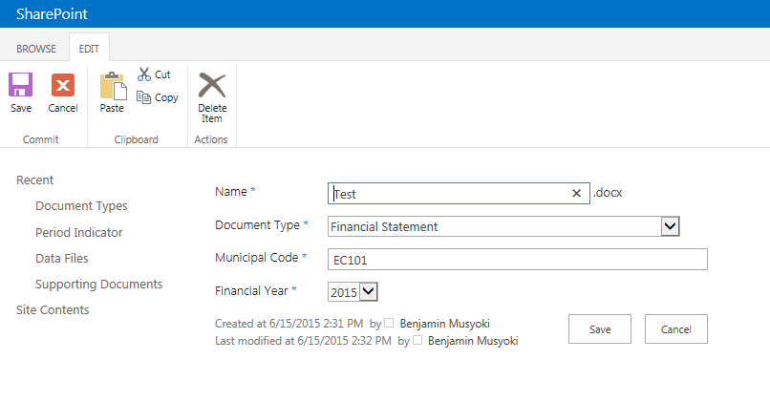
Supporting documents

Slide 16
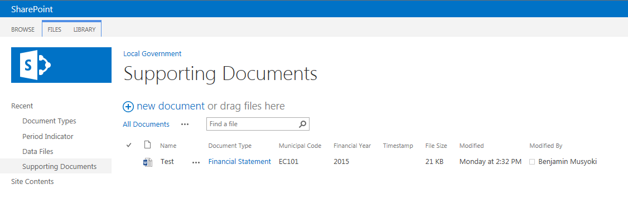
Supporting documents

Slide 17
Future financial statistical reporting possibilities
The implementation of the mSCOA will enable all national and provincial departments to report on 5 additional dimensions of financial data:
Project related information
Funding of expenditure in more detail
Benefits per area of the municipality
Proper costing of services as well as FBS
Detail available will be driven by lowest common posting level for all municipalities in the mSCOA.
As the mSCOA classification largely corresponds to the SCOA implemented for national and provincial departments, local government will finally become part of the “bigger” picture and financial statistics will reflect whole of government.
The added dimensions will also provide better information to determine policy changes and will enable better monitoring of the implementation of policies and allocations.
While the initial focus will be on the translation of the 6 segments into the current GFS-item classification, the total framework for reporting and analysis in the LGDRS will be expanded and will eventually cover all mSCOA segments.
Adding all segments into the current reporting capabilities will offer a mind-blowing set of possibilities – IF the quality of the financial data is secured and tamper proof, as well as correctly classified through well-defined business processes that guide the capturing of all transactions.

Slide 18
THANK YOU

