Slide 1

LG DATABASE AND REPORTING SYSTEM (LGDRS)
8-9 September 2015
Presented by National Treasury: Cornéll Botha – 9 September 2015
Notes:
1

Slide 2

Road Map – where we are now
LG DATA BASE
Configuration and amendments to the LG Database, based on the SCOA classification framework
Testing of in-year reporting based on refined LG Database
Development and testing of report extraction
Change management associated with redeveloped LG Database
Continuation with in-year reporting framework, verification, and publications including piloting municipalities

Slide 3
Progress to date
Upload portal for both financial batch submissions and documents developed and implemented
mSCOA FAQ database is now hosted at NT and have been updated for more stability and functionality
The design and data flow for the storing and handling of financial information has been finalised
The content and validation rules for financial batch files have been defined
The communication lines and rules regarding delegation of authority has been discussed and will shortly be finalised
SCOA Risk Matrix has been created and is also hosted by NT. It will be communicated as soon as it is available from outside, which SITA is finalising.

Slide 4
Work plan for the next 3 months
The SQL database will be created and the validation rules implemented,
The communication setup will be implemented based on the current contacts per municipality already available on the current database,
The current contact database will be expanded to accommodate a wider base of entry points into the municipalities and metros, however, this is still a discussion point,
The mSCOA tables will be moved from Excel to a SQL database and audit trails will be added,
Translation of new format financial data into old reporting formats will be done for quality and accuracy checks, and
Development of new reports will commence

Slide 5
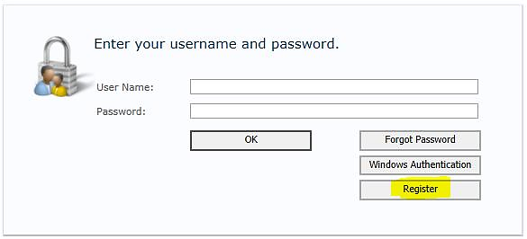
Local Government Data UPLOAD System: collecting municipal data
The municipal managers have to register to get access
approval on the Local Government Upload portal. The web address is https://lguploadportal.treasury.gov.za
Notes:
The municipal managers have to register

Slide 6
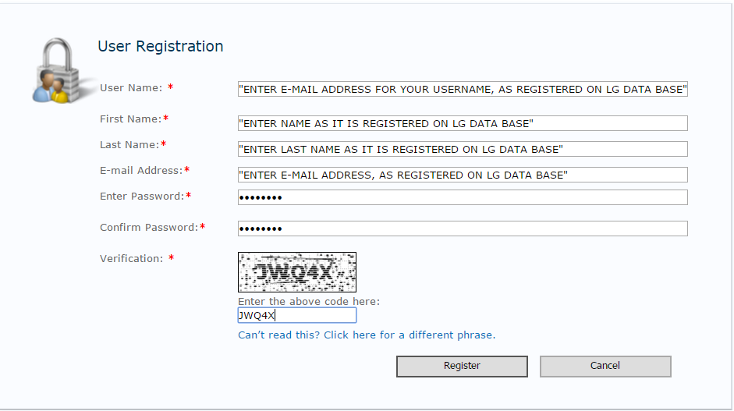
Local Government Data UPLOAD System: collecting municipal data

Slide 7
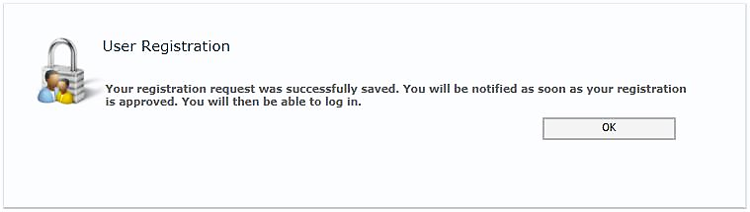
Local Government Data UPLOAD System: collecting municipal data

Slide 8
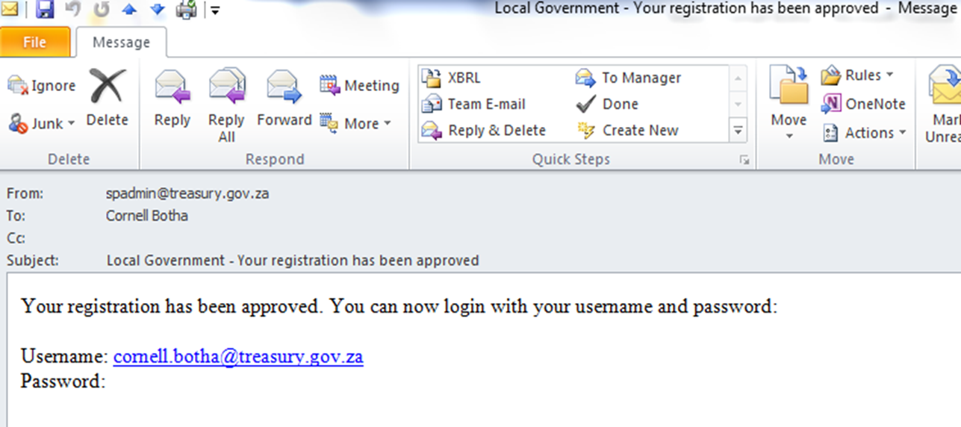
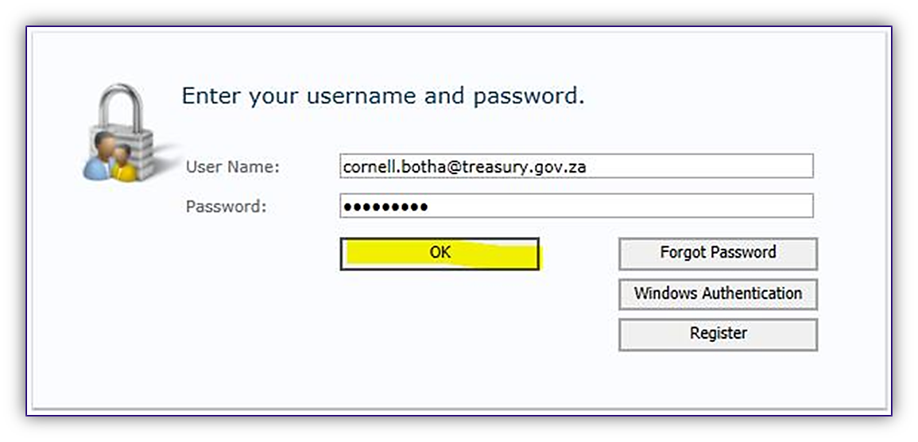
LG Data and Document Upload Portal

Slide 9
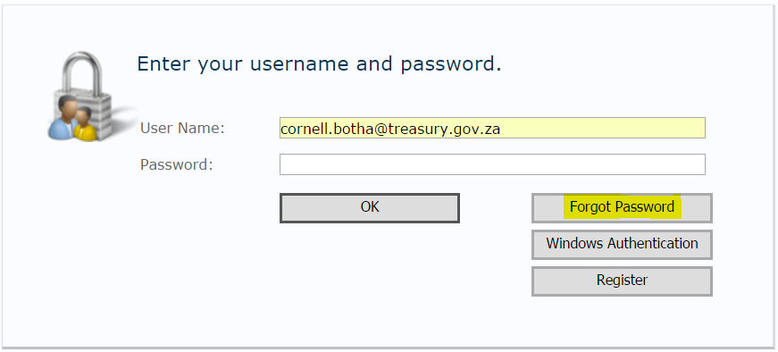
LG Data and Document Upload Portal

Slide 10
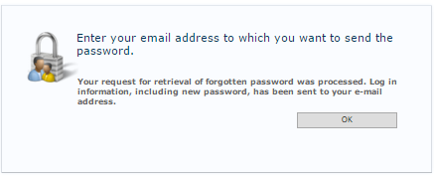
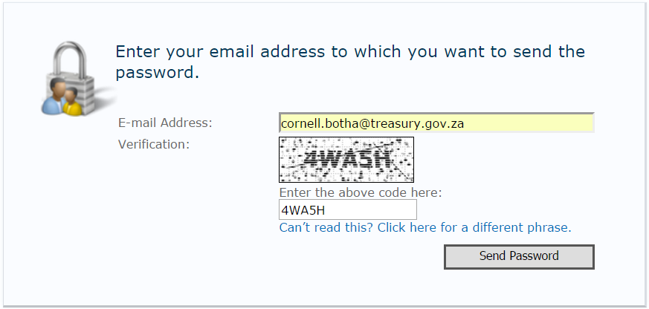
LG Data and Document Upload Portal

Slide 11
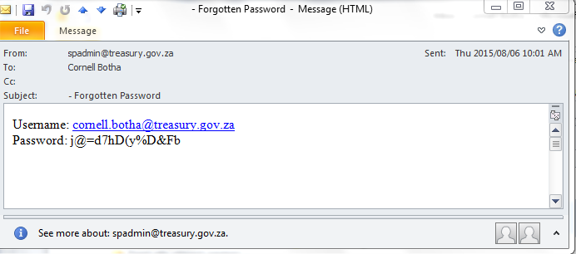
LG Data and Document Upload Portal
Notes:
Copy and sign on with forgotten (encrypted) password and change password

Slide 12
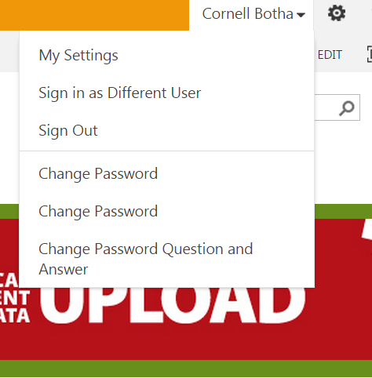
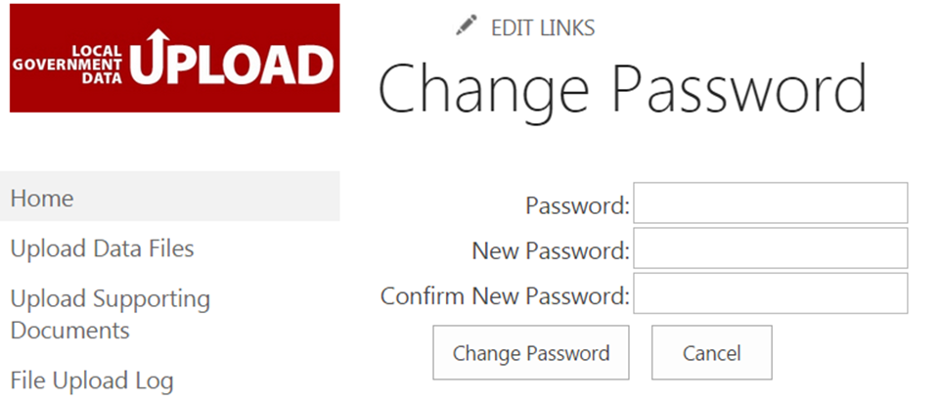
LG Data and Document Upload Portal

Slide 13
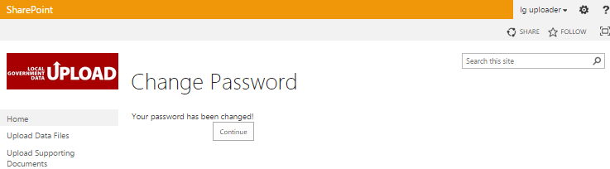
LG Data and Document Upload Portal

Slide 14
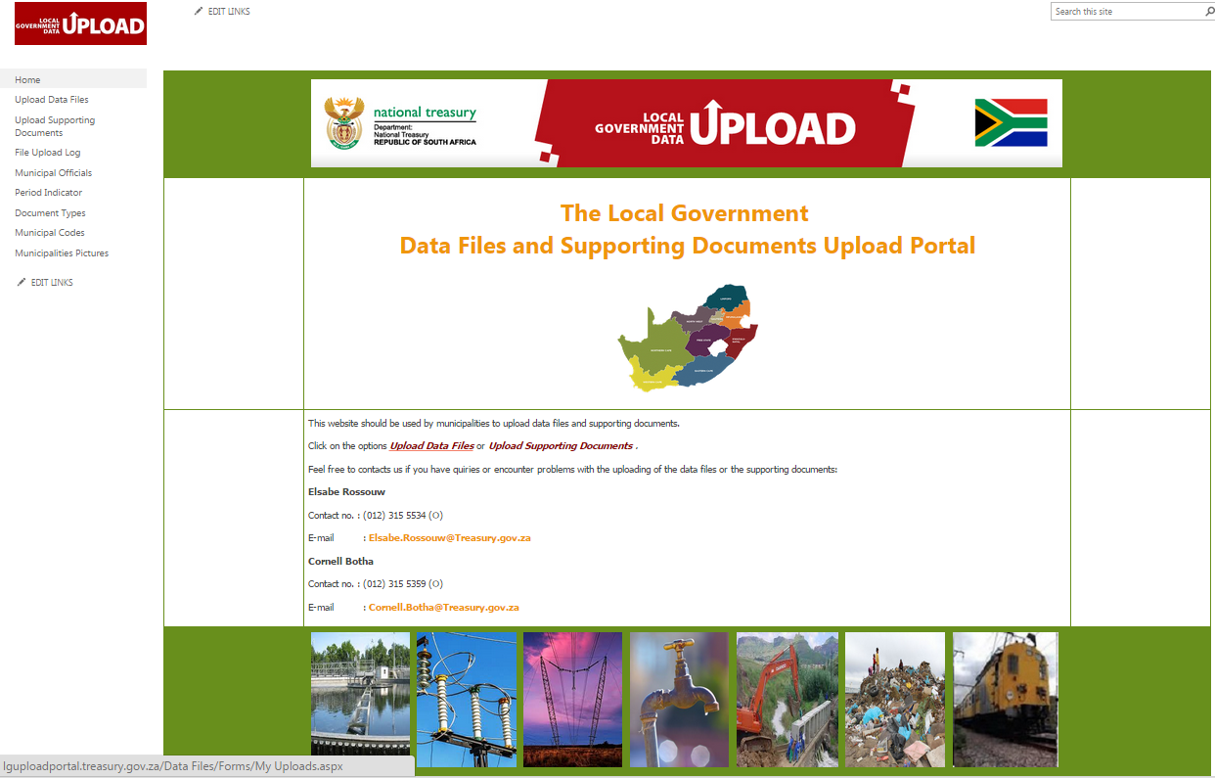

LG Data and Document Upload Portal

Slide 15
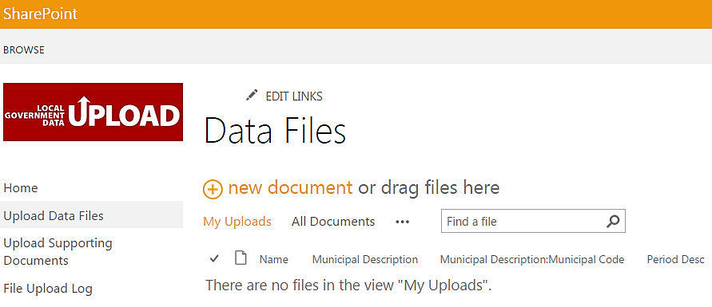
LG Data and Document Upload Portal

Slide 16
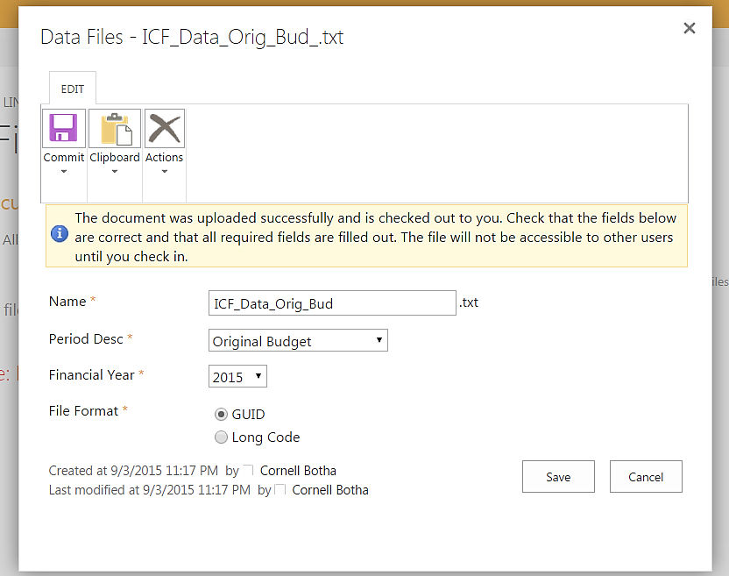
LG Data and Document Upload Portal

Slide 17
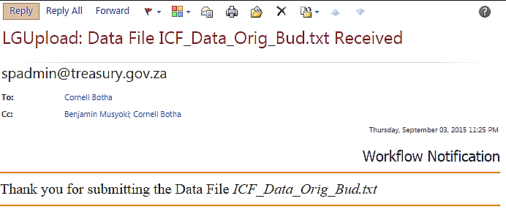
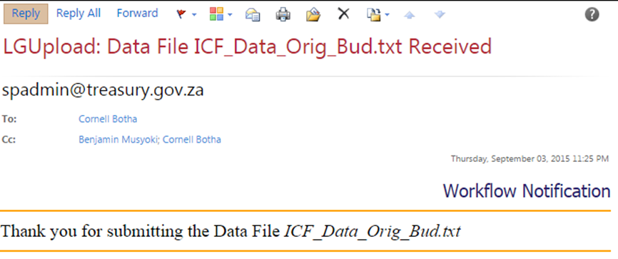
LG Data and Document Upload Portal

Slide 18
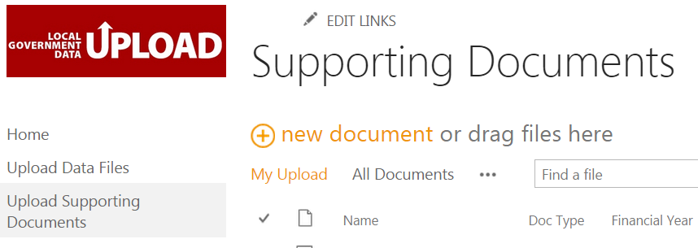
LG Data and Document Upload Portal

Slide 19
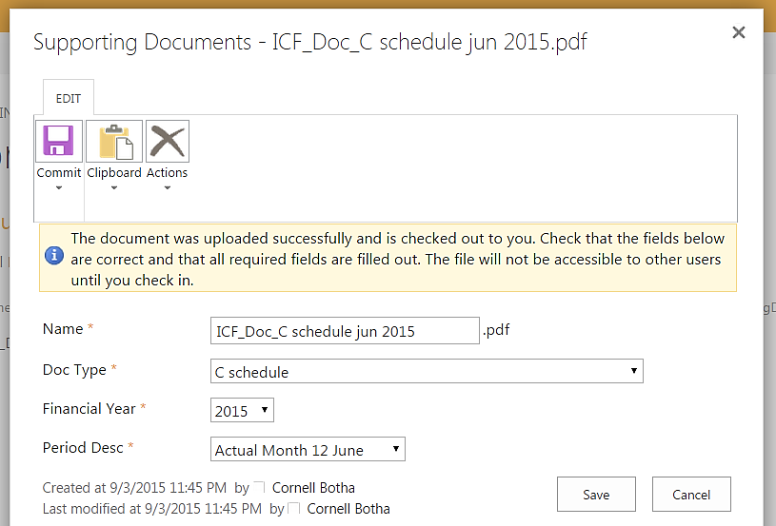
LG Data and Document Upload Portal

Slide 20
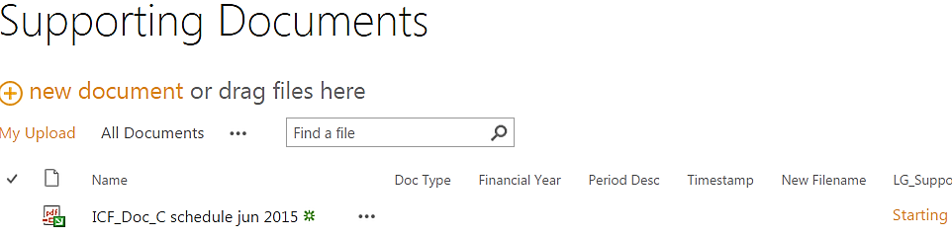
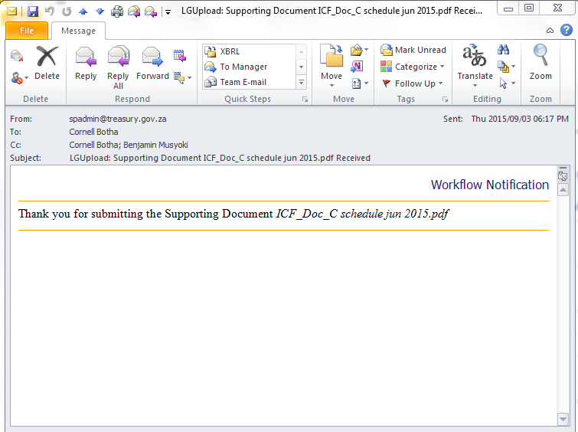
LG Data and Document Upload Portal

Slide 21
LG Data and Document Upload Portal

Slide 22
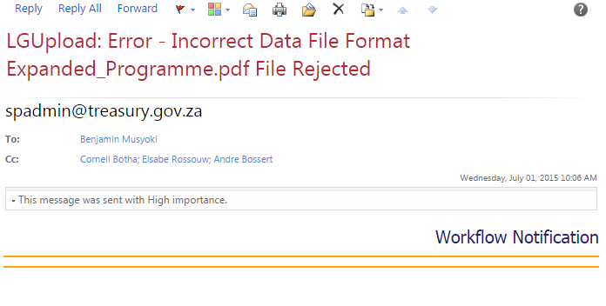
LG Data and Document Upload Portal

Slide 23
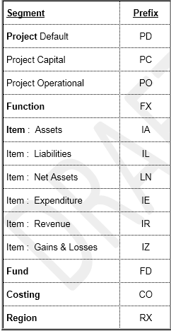
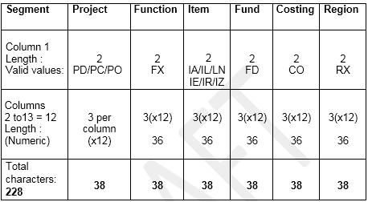
LG Data and Document Upload Portal
Data Upload Requirements

Slide 24
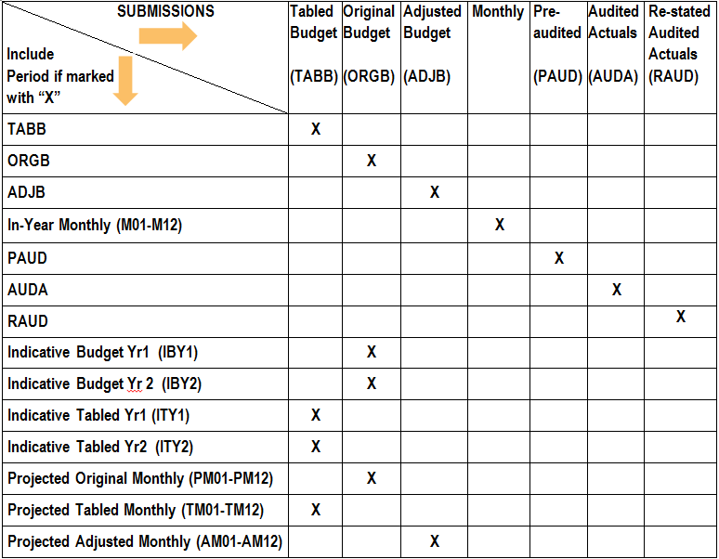
LG Data and Document Upload Portal
DATA UPLOAD

Slide 25
LG Data and Document Upload Portal
Supporting Documents Upload Requirements
The submission of Supporting Documents on the LG Data Upload portal requires that only single documents corresponding to the selection type available, be uploaded at a time.
For example: Council resolutions or quality certificates may no longer be included in a budget document but must be uploaded as separate document.

Slide 26

LG Data and Document Upload Portal
Other Requirements
1) All municipal managers of participating pilot municipalities, who have not registered on the upload portal yet, are requested to register as soon as possible.
2) Approval of portal access can only be granted after registration.
3) Upload of files and documents can only commence after the municipal manager’s authorisation. Submission to the new portal should be synchronised with the current e-mail procedure.
(MM) Register
(NT) Approve
(MM) Submit

Slide 27
LG Data and Document Upload Portal
Other Requirements
4) It is important that the pilot municipalities test the portal extensively, e.g. big documents (in PDF format), to assure quality of this interface. After a successful pilot phase, the portal can be rolled out to 278 municipalities.
5) The communication setup will be implemented based on the current contact details of the municipal manager. This poses a problem as the MM might not always be available. What and how to setup the communication process is a discussion point and consensus should be reached as soon as possible. Feedback from municipalities in this regard, will be valuable and highly appreciated. National Treasury has defined options and will take it up with Municipalities before finalisation.

Slide 28
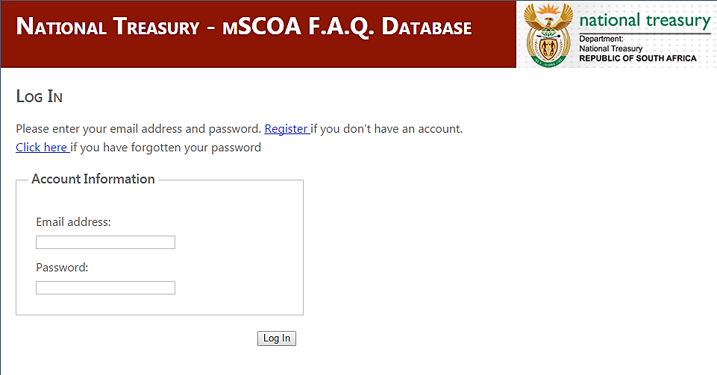
mSCOA F.A.Q. Portal
Municipalities may register to get access and
approval on the MSCOA F.A.Q. database. The web address is http://mscoafaq.treasury.gov.za

Slide 29
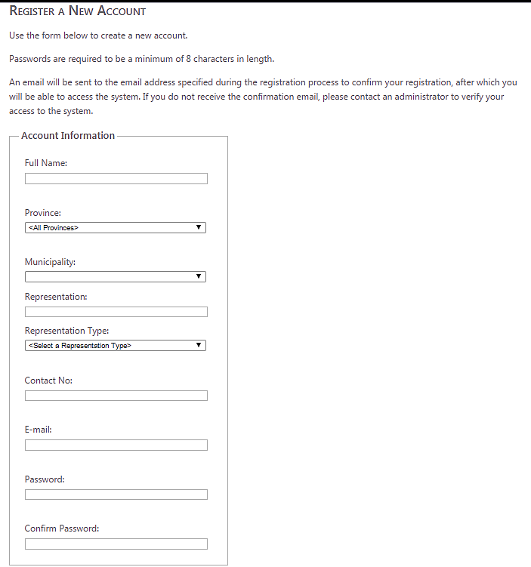
mSCOA F.A.Q. Portal
*The user will receive a registration confirmation e-mail with a link to click on to access the F.A.Q. portal but will not be able to use it.
*The administrator at NT to activate the account.

Slide 30
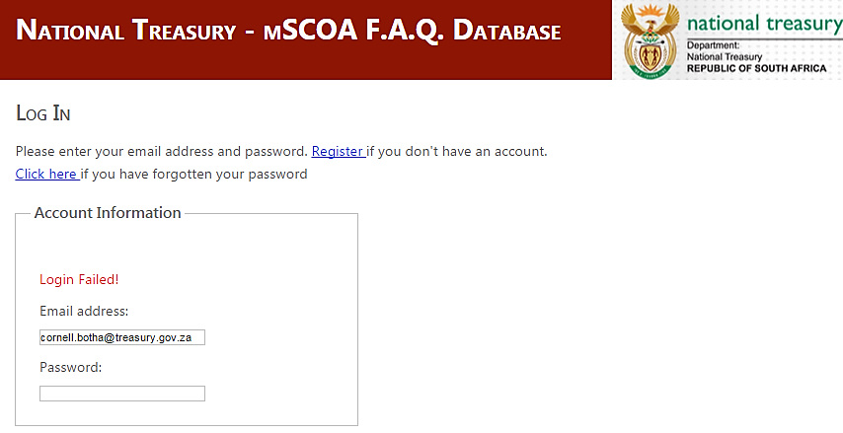
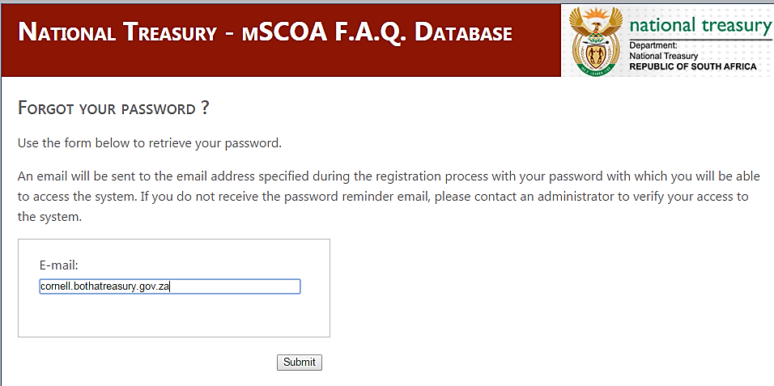
mSCOA F.A.Q. Portal

Slide 31
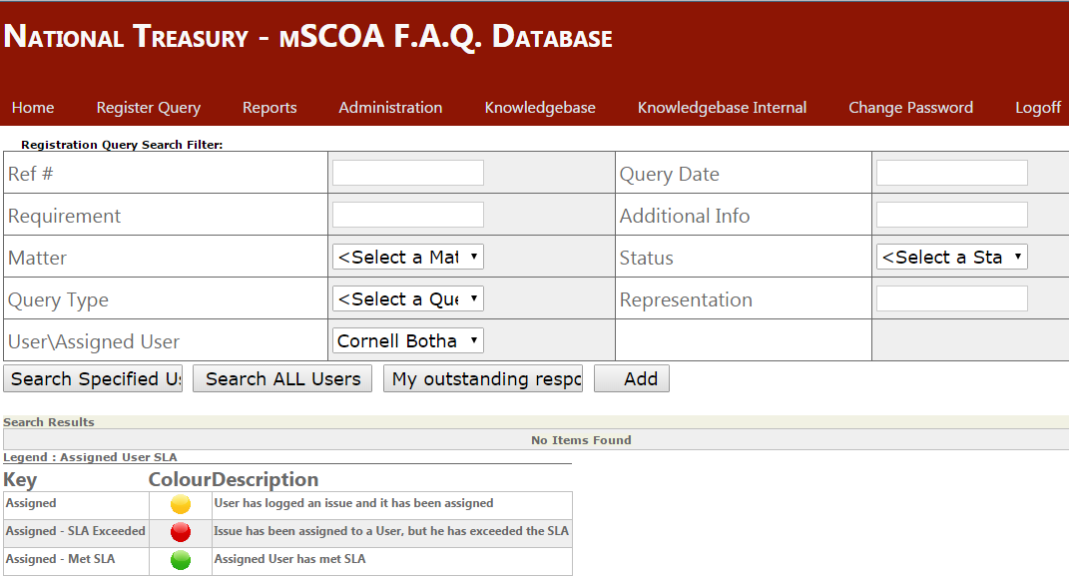
mSCOA F.A.Q. Portal

Slide 32
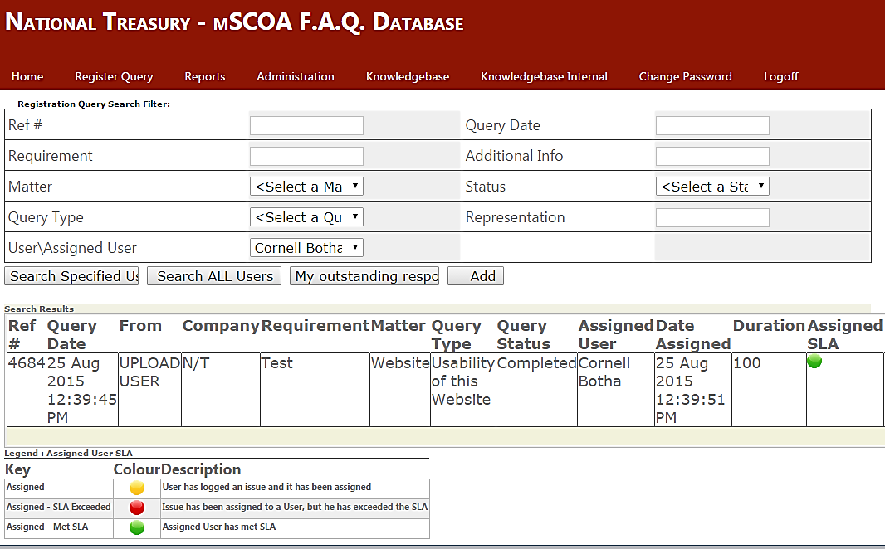
mSCOA F.A.Q. Portal

Slide 33
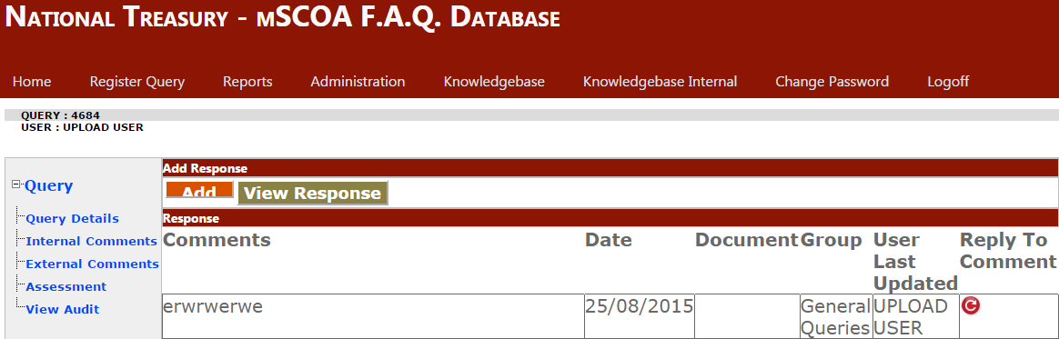
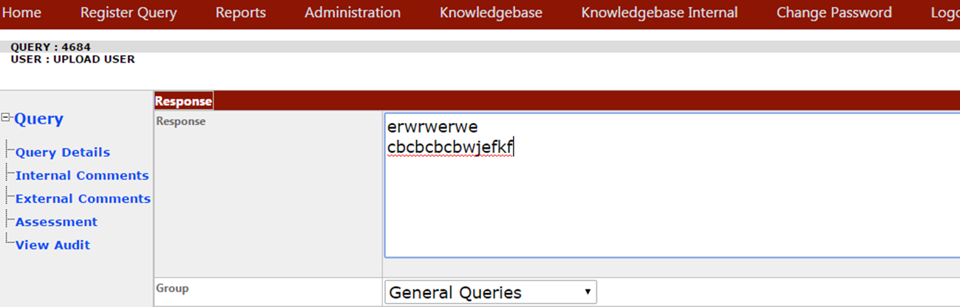
mSCOA F.A.Q. Portal

Slide 34
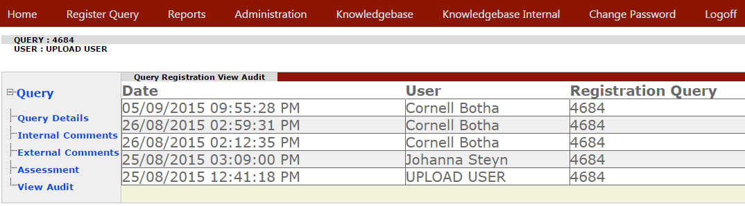
mSCOA F.A.Q. Portal

Slide 35
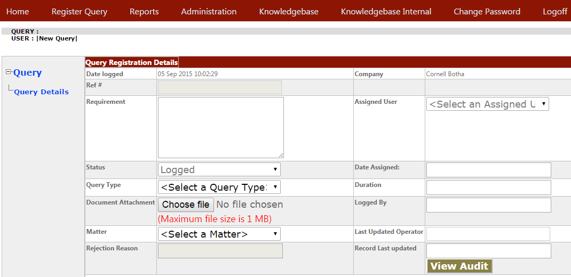
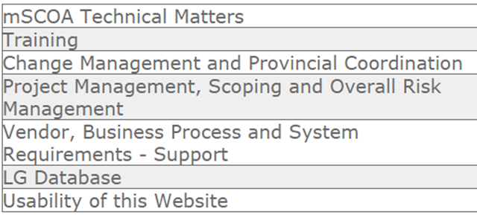
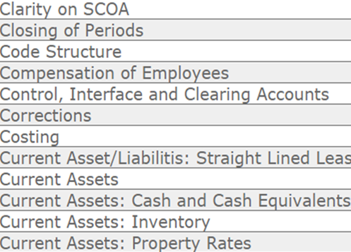
mSCOA F.A.Q. Portal

Slide 36

LG Data and Document Upload Portal
Contact me for any questions or problems you encounter with regards to the LG Upload Portal or the mSCOA FAQ portal for assistance.
Cornell.Botha@Treasury.gov.za
(012) 315 5359
082 449 4840

Slide 37
THANK YOU

