Slide 1

MSCOA : Position Papers

Slide 2
Outline:
Background
Objectives
Position papers
Debtors
Free Basic Services
Funds and Reserves
Subsidies and Transfers
Water Balance Reporting
Reclassifications
Way forward

Slide 3
Background
Principles defined in the mSCOA Design Framework:
Central point of access for all local government information
Improved data quality and integrity
Uniform classification framework
Standardised through the classification framework
Supported by a modernised system application
GRAP reporting in the context of mSCOA:
Annual Financial Statements presented to Council, Provincial Legislatures, Parliament and other stakeholders
Budgeting framework in terms of National Treasury
Legislative framework

Slide 4
Objective
MSCOA framework, GRAP framework & Budget Framework
Platform to debate transversal issues
Consensus on issues between all stakeholders including
National Treasury mSCOA, Accountant-General, Auditor-General, ASB, NERSA, DWA and most importantly Municipalities
Consistent application of matters affecting MSCOA
Discussion Papers= subject matter driven linking MSCOA to phase 1 existing reporting format & phase 2 future reporting
Position Papers= authoritative guidance on specific issues related to MSCOA
Not replacing legislation, circulars, NT guidelines, practice notes or implementation guidelines- i.e, these prevail

Slide 5
Debtors
Impairment of debtors in terms of GRAP 104/ GRAP 108
Impairment allowances
Debts written off in terms of Council Resolution
Inconsistent application of the write off
Utilisation of provision or
Statement of financial performance
Draft position
Debt write off to be expensed to statement of financial performance
Assessment of impairment allowance to be performed annually from an AFS perspective

Slide 6
Cost of Free Basic Services
Cost of Free Basic Services are funded by the fiscus through the Equitable Share
Funding and Cost of Free Basic Services are not disclosed in the Annual Financial Statements in terms of GRAP due to the following:
Revenue recognised in terms of GRAP 23 as Non-exchange revenue through the Equitable Share
Cost of Commodity included in Bulk Purchases/ Expenses
Differing practices within municipalities
Free Basic Services Provided constitutionally
Indigent Debtors
Specific Municipality rebates

Slide 7
Documents
The following documents have been consulted regarding budgeting & accounting for Free Basic Services (FBS)
Circular 51 – par 6.4 Revenue & Revenue Foregone
Circular 58 – par 6.8 & 6.9 Cost of FBS vs Revenue Cost of Free Services
GRAP 9 Revenue From Exchange Transactions
GRAP 23 Revenue From Non-exchange Transactions (Taxes And Transfers)
IGRAP 1 Applying The Probability Test On Initial Recognition Of Revenue
FAQ on FBS - ASB website
2015 DoRA

Slide 8
Budgeting for Free Basic Services – Current Position
FBS subsidised from the basic services component of the Equitable Share
Basic services component of ES provides a subsidy of R313.76 per month in 2015/16 for households below the monthly household income of R2 300 for the cost of providing basic services: 6kl Water, 50 Kwh electricity, refuse removal, sanitation
Subsidy as per national standard
Non-cash grant SA21 => A4
Subsidy above national standard (additional subsidy)
Revenue forgone – subtract on SA1
Free Basic Alternative Energy supplied to indigent households – Where electricity is not available
Cash grant SA21 => A4
Free Basic Electricity to indigent households – where Eskom holds the license
Payment to Eskom – Cash grant SA21 => A4

Slide 9
Budgeting for Free Basic Services – Current Position
Property rates (Not FBS as per the definition of the Equitable Share Formula)
Impermissible values as per MPRA
Section 17 (1) of MPRA (R15 000, 30%PSI, public worship, etc.).
Section 2 of Regulation on Ratio Between Residential/Non-Residential Category of Property (Government Gazette 33016, 12 March 2010)
Do not levy - Not revenue forgone neither non-cash grant
Higher values than impermissible values
Revenue forgone – subtract on SA1
Rebate/reduction/exemption in terms of sect 15(1) of MPRA to all ratepayers of a particular category (property or owners) as defined in subsection 15(2)
Revenue forgone – subtract on SA1
Rebate/reduction/exemption in terms of sect 15(1) of MPRA to some ratepayers or an individual of a particular category (property or owners) as defined in subsection 15(2)
Non-cash grant SA21 => A4

Slide 10
Budgeting for Free Basic Services – Current Position
Grants to Institutions
Cash Grant/transfer to institution
Cash grant SA21 => A4

Slide 11
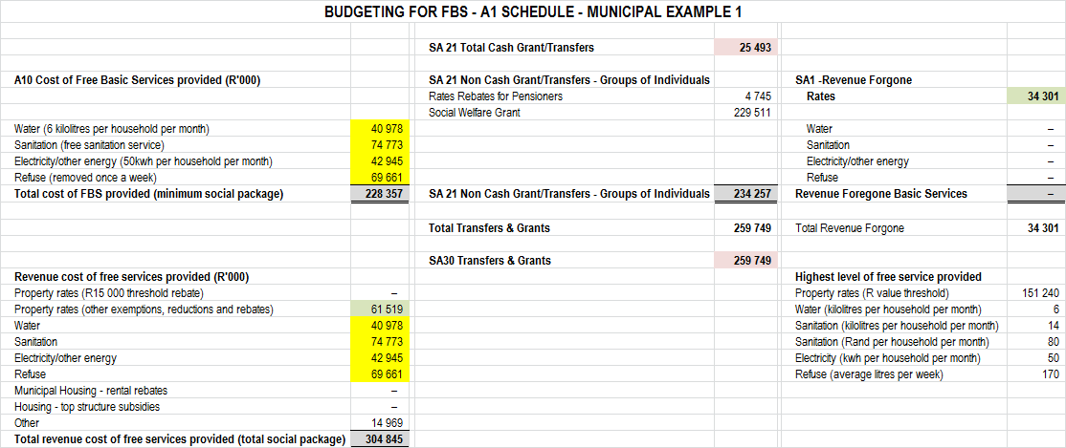
Inconsistent Interpretations by Municipalities Example 1
Cost of FBS A10 close to non-cash grants on SA21
Cost of FBS = revenue cost of free services – Questionable as to what was used for determining cost ?
Revenue forgone rates appears to be understated by R27.2 million
FBS was expenses on cash flow SA30 & A7 - not shown as revenue foregone
Revenue on cash flow possible overstatement of R 27.2 million

Slide 12
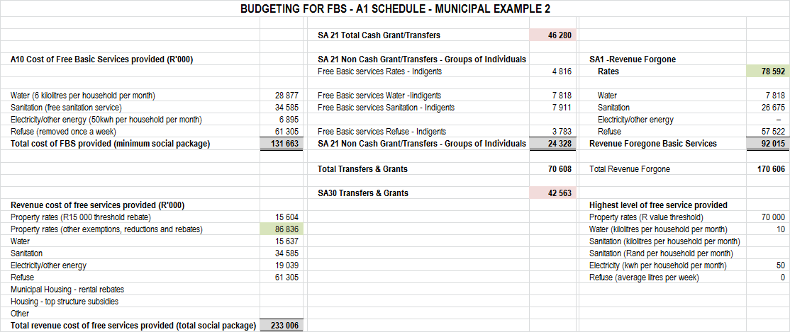
Inconsistent Interpretations by Municipalities Example 2
Cost of FBS A10 differ by R107.3 million to non-cash grants on SA21
Revenue forgone rates appears to be understated by R8.2 million
FBS was not expenses on cash flow SA30 & A7 – only cash grants & transfers - understated by R3.7 million
Revenue forgone for services appears to be understated by R39.6 million
Revenue on cash flow possible overstatement of R 51.5 million

Slide 13
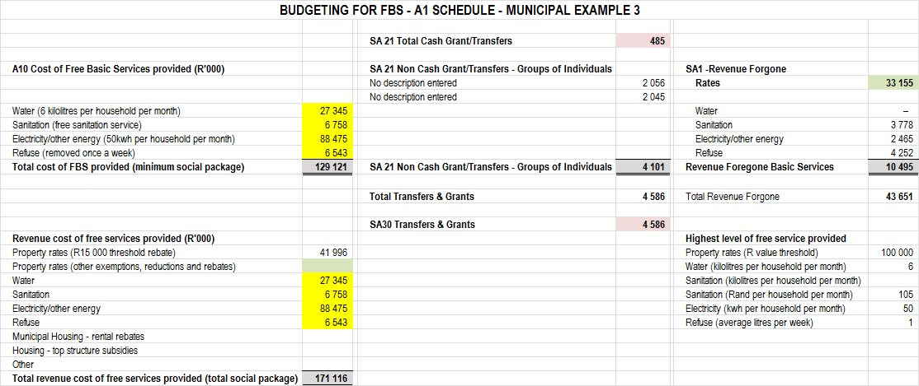
Inconsistent Interpretations by Municipalities Example 3
Cost of FBS A10 differ by R125.0 million to non-cash grants on SA21
Cost of FBS = revenue cost of free services – Questionable as to what was used for determining cost ?
Revenue forgone rates appears to be understated by R8.8 million
FBS was not fully expenses on cash flow SA30 & A7
Revenue forgone for services appears to be understated by R114.5 million
Revenue on cash flow possible overstatement of R 123.3 million

Slide 14
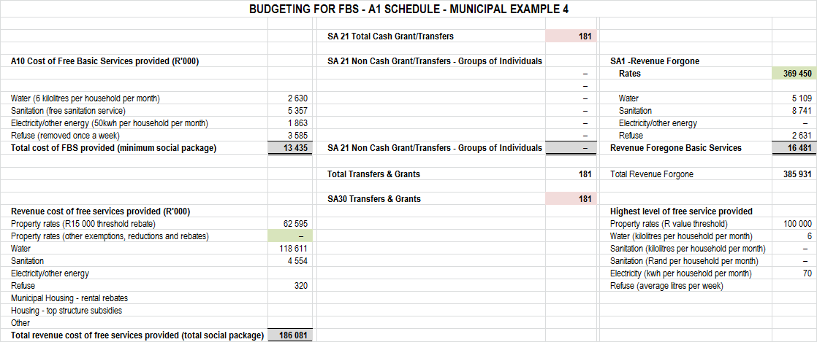
Inconsistent Interpretations by Municipalities Example 4
Cost of FBS A10 differ by R13.40 million to non-cash grants on SA21
Revenue Forgone Rates appears to be overstated by R306.8 million
FBS was not expenses on cash flow SA30 & A7
Revenue Forgone for services appears to be overstated by R3.0 million
Revenue on cash flow possible understatement of R 309.8 million

Slide 15
GRAP Reporting Framework
No definition for revenue forgone in any accounting standard
GRAP 9 - Revenue From Exchange Transactions
Measurement of revenue
.15 Revenue shall be measured at the fair value of the consideration received or receivable.
.16 The amount of revenue arising on a transaction is usually determined by agreement between the entity and the purchaser or user of the asset or service. It is measured at the fair value of the consideration received or receivable taking into account the amount of any trade discounts and volume rebates allowed by the entity.
.17 In most cases, the consideration is in the form of cash or cash equivalents and the amount of revenue is the amount of cash or cash equivalents received or receivable.

Slide 16
GRAP Reporting Framework
GRAP 23 Revenue From Non-exchange Transactions (Taxes And Transfers)
Definitions
.05 The following terms are used in this Standard with the meanings specified:
Tax expenditures are preferential provisions of the tax law that provide certain taxpayers with concessions that are not available to others.
.71 Taxation revenue shall not be grossed up for the amount of tax expenditures.
.72 Tax expenditures are foregone revenue, not expenses, and do not give rise to inflows or outflows of resources – that is, they do not give rise to assets, liabilities, revenue or expenses of the taxing government.

Slide 17
GRAP Reporting Framework
I-GRAP 1
Scope
.04 This Interpretation of the Standards of GRAP addresses the manner in which an entity applies the probability test on initial recognition of:
(a) exchange revenue in accordance with the Standard of GRAP on Revenue from Exchange Transactions, and
(b) non-exchange revenue in accordance with the Standard of GRAP on Revenue from Non-exchange Transactions (Taxes and Transfers).
.06 This Interpretation of the Standards of GRAP does not deal with:
(a)……………..
(b)……………..
(c) exchange or non-exchange transactions where there is no intention to charge for all or some services. Examples include goods and services provided to indigent consumers or households or rebates deducted on the provision or acquisition of certain goods or services.

Slide 18
GRAP Reporting Framework
FAQ’s on the Standards of GRAP
Is revenue foregone recognised in the statement of financial performance?
In the public sector, entities frequently provide goods and services to consumers for free or at subsidised amounts, while rebates or similar reductions may be granted on taxes or other fees due.
2. Questions have been raised about whether these subsidies, rebates or similar reductions should be recognised as revenue. IGRAP 1 Applying the Probability Test on the Initial Recognition of Revenue, states the following:
3.This Interpretation of the Standards of GRAP does not deal with:
c. exchange or non-exchange transactions where there is no intention to charge for all or some services. Examples include goods and services provided to indigent consumers or households or rebates deducted on the provision or acquisition of certain goods or services.
4. IGRAP 1 clearly only applies to those amounts that the entity intends to collect. As entities do not intend to collect the revenue related to the subsidised goods and services or other rebates, these amounts should not be recognised as revenue.

Slide 19
GRAP Reporting Framework vs Equitable Share Policy Implementation
GRAP Reporting Framework
Indigent subsidies for basic services, rebates or similar reductions should not be recognised as revenue – should be treated as revenue forgone
This position will meet the GRAP reporting framework that Municipalities need to comply with
Equitable Share Policy Implementation
Equitable share not a conditional grant
Structure of the local government equitable share formula - DoRA
Consists of three parts, made up of five components:
First part of the formula consists of the basic services component, which provides for the cost of free basic services for poor households.
subsidy includes funding for the provision of
free basic water (6 kilolitres per poor household per month),
energy (50 kilowatt-hours per month)
sanitation and
refuse
Reporting on policy implementation increasingly important

Slide 20
GRAP Reporting Framework vs Equitable Share Policy Implementation
From policy implementing perspective
Subsidies and rebates to indigent households to be disclosed separately –
supporting budget schedules
separate vote in the revenue section of the chart of accounts to enable data extraction for reporting
“Revenue Forgone – Indigent Support”
Revenue forgone other than indigent subsidies and rebates to be disclosed separately –
supporting budget schedules
separate vote in the revenue section of the chart of accounts to enable data extraction for reporting
“Revenue Forgone – Non-Indigent Free Services”
From GRAP reporting framework
Net off the two “Revenue Forgone” votes against the revenue vote

Slide 21
GRAP Reporting Framework vs Equitable Share Policy Implementation - Disclosure
Disclosure Without Free Basic Services to Indigent Households
Gross Revenue - R10 000 000
Revenue Forgone – Non-Indigent Free Services R 1 000 000
Net Revenue R 9 000 000
Disclosure With Free Basic Services to Indigent Households
Gross Revenue - R10 000 000
Revenue Forgone – Non-Indigent Free Services R 1 000 000
Revenue Forgone – Indigent Support R 2 500 000
Transfers Operational – Equitable Share -R 2 500 000
Net Revenue R 9 000 000

Slide 22
Principles
All indigent accounts are billed for all services monthly
Indigent tariffs should be calculated at the level of the cost of providing the service to bring the cost of the subsidy in line with the DoRA allocation
Indigent accounts are then subsidised monthly
passing a subsidy (credit) on the account
debit “Revenue Forgone – Indigent Support”
“Revenue Forgone – Indigent Support” (subsidy) will not be disclosed as a non-cash transfer in the Statement of Financial Performance but will be treated as revenue foregone18
Subsidy passed on the indigent account is funded by an equal contribution from the Equitable Share
“Revenue Forgone – Indigent Support” is disclosed separately on the supporting budget tables and then netting it off against gross revenue on supporting budget schedule SA1 prior to disclosing Net Budgeted Revenue on budget schedule A4

Slide 23
Funds & Reserves
In terms of GRAP, reserves accounting is only allowed in the following standards
GRAP 17, through the Revaluation Reserve
GRAP 104 (through IAS 39) for complex financial instruments
GRAP therefore requires that transactions are recorded in the Statement of Financial Performance and Statement of Financial Position
GRAP does not explicitly restrict the utilisation of reserves provided that the amounts are included in the Accumulated Surplus
Municipal funding and budgeting has been, and in some cases currently based on the Reserves/ Funds that the Municipalities has accumulated
Risk of unfunded budget due to liquidity issues

Slide 24
Funds & Reserves
The following internal funds and reserves were established in the past:
Capital Replacement Reserve (CRR), Self Insurance Reserve (SIR), Capitalisation Reserve (CR), Reserve established for Compensation for occupational Injuries and Diseases (COID Reserve), Government Grant Reserve (GGR) and Donations and Public Contributions Reserve
Preference of National Treasury is that the Separation of Accumulated Surplus into the Reserves should not be done
Utilisation of Reserves can be utilised but only under the following circumstances:
Policy for the reserve including the funding requirements if the reserve is not cash backed approved by Council
At a minimum 40% of the reserve must be cash backed

Slide 25
Transfers and subsidies
Generally, transfers received non-exchange transactions
Subsidies provided also non-exchange
Licence fees- may be either depending on the services provided and the definition of exchange vs non-exchange in GRAP 9/23
Must document the judgement in terms of GRAP 3

Slide 26
Water balance reporting
Department of Water and Sanitation require information from Municipalities to manage the supply of water
Water constitutes inventory in terms of GRAP 12
Differing practices throughout the country
Interim position:
Record the water balance in terms of GRAP 12 at year-end
Calculate the water losses in terms of Circular 71
Disclose the amount of water purchased

Slide 27
Water balance reporting
Final position:
Municipality must at each month end, year-end calculate the amount of Water Balance at year-end
Municipality must record the amount of Water Purchased
Municipality must calculate the Cost of Sales
Municipality must calculate the amount of Free Basic Service
Municipality must calculate the amount of losses
Amount of losses incurred due to infrastructure losses
Amount of losses incurred due to natural losses such as evaporation losses
Amount of losses due to theft or pilferage
Municipality must disclose water gains
Municipality must prepare a reconciliation

Slide 28
Comparatives and restatements
Changes as a result of the application in the MSCOA results in classifications issues
Consideration of Materiality
Consideration whether Annual Financial Statement issue
Impact of Prior Period Errors/ misstatements/ change in accounting policies/ change in estimates

Slide 29
Way forward
Draft position papers to be approved by MSCOA Project Steering Committee for comments
Comments opened to MSCOA ICF and other stakeholders
Meetings with key stakeholders including Auditor-General, ASB, Provincial Accountant-General etc.. to be conducted
All comments will be considered
Final position paper to be approved MSCOA Project Steering Committee and included on National Treasury website

Slide 30
Questions
Questions

