Slide 1

ICF 22 June 2015 mSCOA Frequently Asked Questions (FAQ) Database
Presented by National Treasury: Chief Directorate Local Government Budget Analysis | 22 June 2015

Slide 2
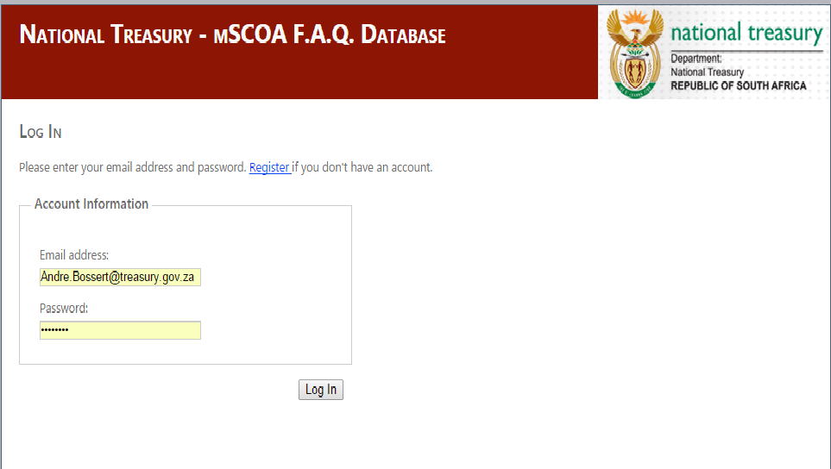
FAQ
http://specialtasks.co.za/SCOATracker/Logon.aspx

Slide 3
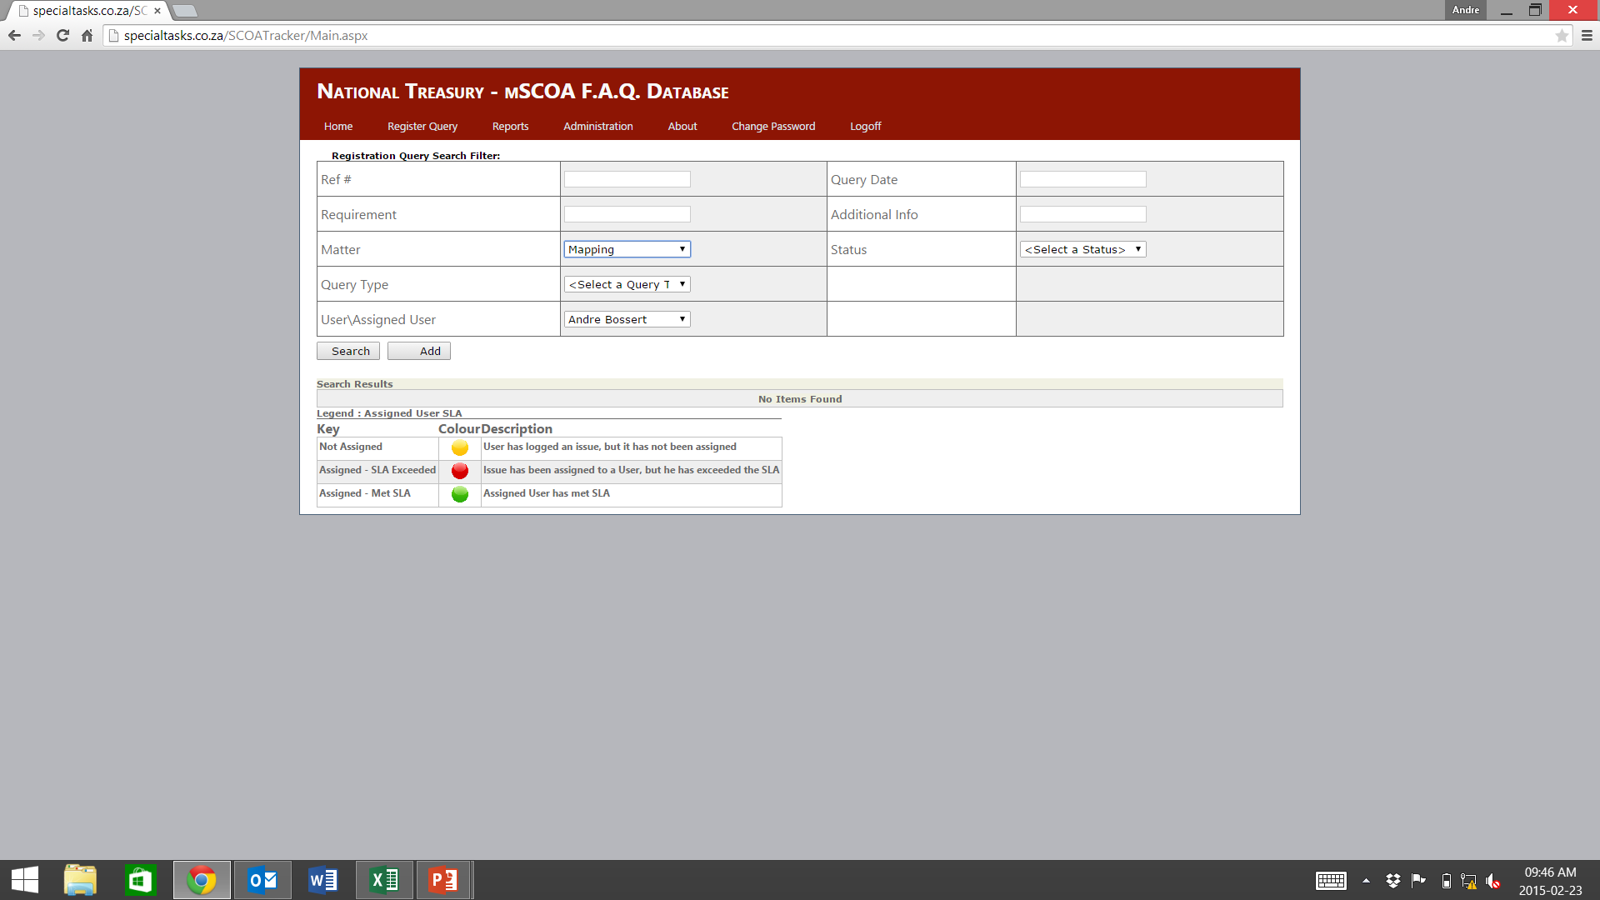
FAQ Database

Slide 4
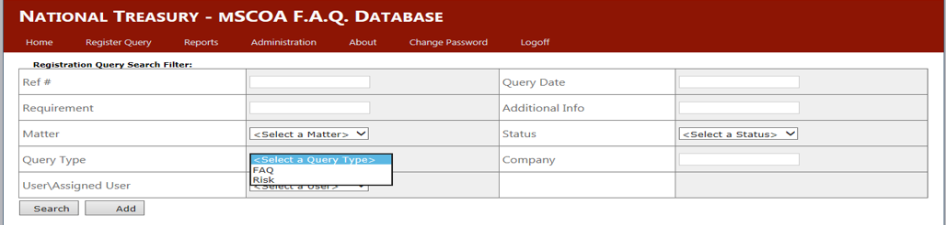
Changes to Query Type
Remove from query type “FAQ or Risk” and replace with:
Technical Matters
Training
Change Management and Provincial Coordination
Project Management, Scoping and Overall Risk Management
Vendor, Business Process and System Requirements - Support

Slide 5
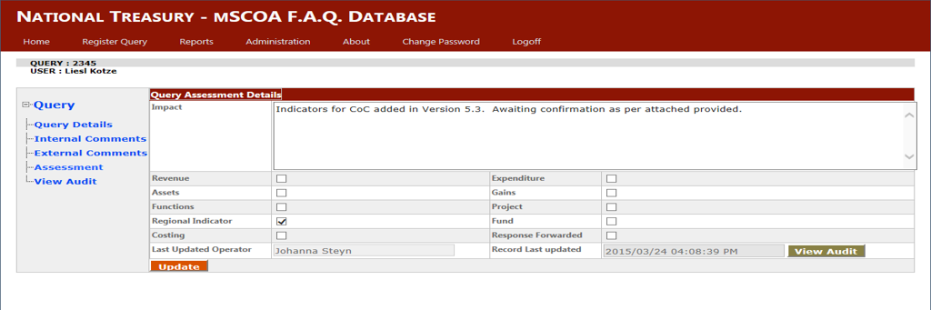
Changes to Assessment Details
Change “assets” to assets, liabilities and net assets
Remove “response forwarded”
Add PSD
Add definition
Allow multiple selection

Slide 6
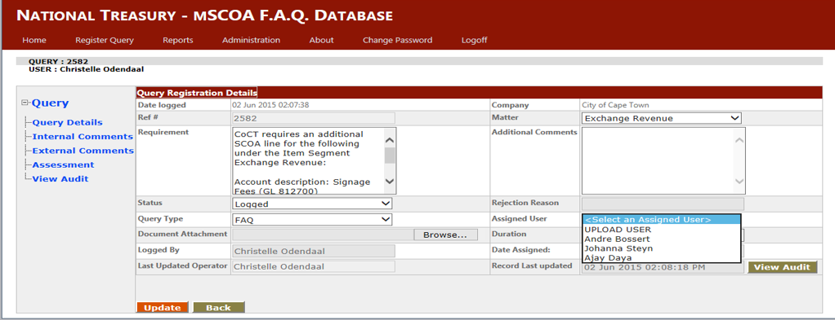
Automatic Assignment linked to Proposed Query Type

Slide 7
FAQ: Work streams
Technical Matters: Johanna Steyn
Training: Ajay Natverlal Daya
Change Management and Provincial Coordination: Silma Koekemoer
Project Management, Scoping and Overall Risk Management: Carl Stroud
Support to Vendors, Business Process and System Requirements: Andre Bossert

Slide 8
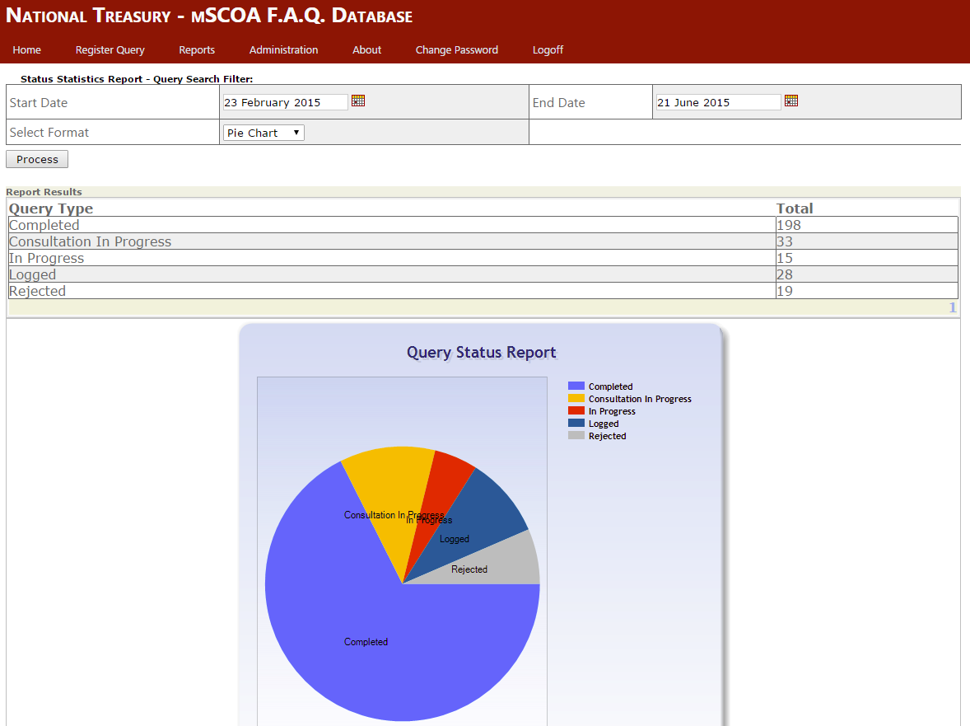
Reports

Slide 9
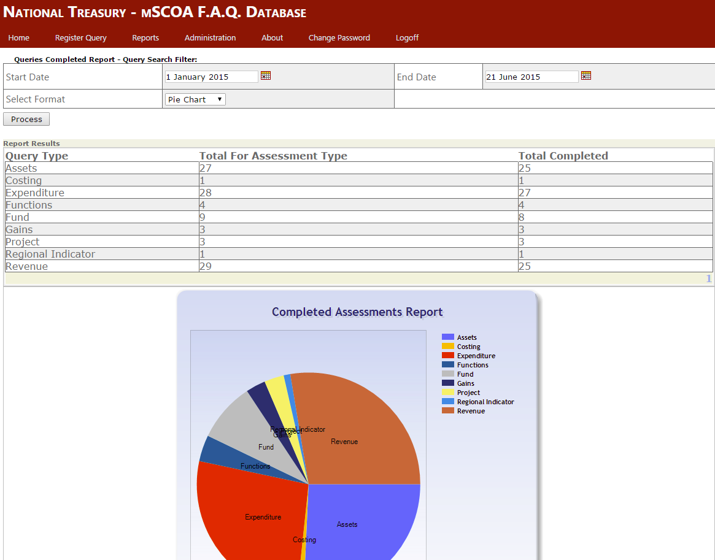
Reports

Slide 10
FAQ: General observations and points to note
To date queries and issues limited to selected municipalities and stakeholders
Pilot municipalities and stakeholders need to note that this is the last opportunity to influence the detail classification framework
Version 6 of mSCOA (TO BE LOCKED DOWN) is at the point of finalisation and the FAQ is the appropriate tool to influence changes as may be required
The FAQ Database to be made available to all municipalities and other stakeholders
No is also an answer…Don’t go opinion hunting in the hope to influence a different outcome
The mSCOA is for all municipalities and is not specific to a specific municipality

Slide 11

Questions

