Slide 1

mSCOA
Phase 4 – Pilot and Change Management
Training Strategy and Way Forward
Presented by National Treasury: Chief Directorate Local Government Budget Analysis

Slide 2
Training initiatives to date
One day information sessions in all provinces – November to December 2014
2 day non accredited training – 9 Sessions from April to May 2015
2 additional one day information sessions for other stakeholders to be held in July 2015
3 day training programme for the IGR directorate in the National Treasury to be held in July 2015

Slide 3
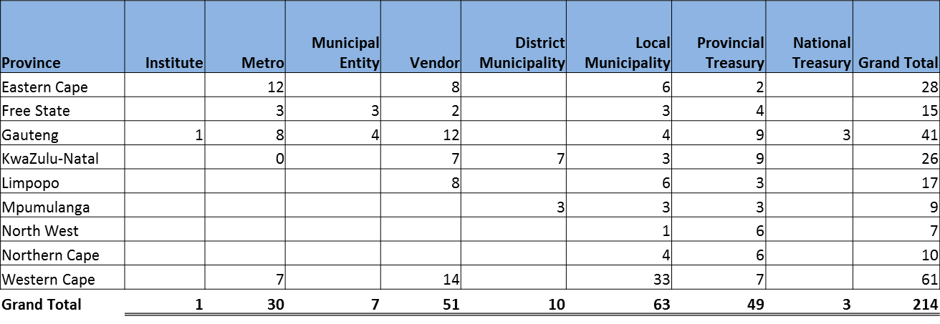
2 day – non accredited training - attendance
The table below represents that statistics relating to the attendance at the 2 day non-accredited training session.

Slide 4
2 day – non accredited training - Feedback
Feedback on Training
  Positively received by practitioners and vendors
  Practical
  Should have been done earlier
  To be rolled out to all municipal officials
  Made mSCOA easy to understand
  No. of days was not sufficient
  Project start vs item start
  Lot more work than initially anticipated
  More examples on reporting

Slide 5
What next for non-accredited?
Due to the significant positive feedback, National Treasury will be embarking on a process of rolling out the non-accredited training programme to 42 district municipalities.
It is envisaged that the rollout will commence at the later part of July and extend for a period of 8 to 10 weeks.
The programme will be 3 days, as it will be addressing mainly the non-pilot sites and thus most of the participants will have little or no knowledge of mSCOA.
This will in all likelihood be funded by the National Treasury.

Slide 6

What next on the training initiative?
In the earlier presentations at ICF and other forums, the next step is to develop unit standards and the related training programmes.

Slide 7

What is Plan B?
Develop the learning programmes in accordance with QCTO requirements
Package the programme into 2 main categories
  Financial practitioners
  Non financial managers
Run the programme as non registered until QCTO process has been finalised by LGSETA

Slide 8
How will plan B roll out?

Slide 9



Now we have non-registered Material – What Next ?
Unit Standards?
QCTO?
Qualifications?
Where do we fit mSCOA?
mSCOA to all municipal officials – get it done
National Treasury
LGSETA
We need a referee

Slide 10
National Treasury – Accreditation/Material
National Treasury will establish a mechanism to accredit mSCOA facilitators (individuals)
Accreditation with LGSETA or via any MOU with another SETA does not translate to automatic accreditation
Emphasis on individual accreditation and not organisation
Ownership of material will be that of the National Treasury as well as version control.
Facilitators will be able to print via a license issued by the National Treasury
No deviations will be allowed in this regard

Slide 11
What are the time lines?

Slide 12

Questions

