Slide 1


mSCOA ICF Project segment and importance of asset classification - Impact on classification and mSCOA
Presented by National Treasury: Louis Boshoff – 22 June 2015

Slide 2
Agenda
Introductions
Definitions used for asset care activities
3.1 Classification of infrastructure and community facilities
3.1 Municipal asset hierarchy
3.2 Practical implication
3.3 NERSA and DWA

Slide 3
Asset hierarchy linked to asset lifecycle activities

Slide 4
Hierarchy of actions and interventions
PROGRAMMES
A group of related projects managed in a coordinated way . Typically, programmes will appear in the IDP and MTREF, linking the envisaged strategic outcomes to the output of the endeavours. (eg. Urban Roads Programme, etc.)
PROJECTS
A project relates to a series of activities with a defined start and end date to deliver predetermined outputs
ACTIVITIES
An activity is defined as a component of work performed during the course of a project, grouped under the following
Initiate;
Plan and design;
Execute works;
Control and monitor;
Reporting;
Close-out
Asset components
Project expenditure
Operational expenditure

Slide 5
Project segment - Capital
Current infrastructure asset sub-class
Airports
Electricity
Roads, Pavements, Bridges and Storm Water
Solid Waste Disposal
Transportation
Water
Waste Water Management
Infrastructure
Land
New
Transfers
Existing
Rehabilitation & Refurbishment
Upgrade & Additions
Asset sub-category detail
Rehabilitation & Refurbishment
Asset sub-category detail
Asset sub-category detail
Asset sub-category detail
Upgrade & Additions
Asset sub-category detail

Slide 6
Project segment - Capital
Current infrastructure asset sub-class
Biological or Cultivated Assets
Buildings
Computer Equipment
Furniture and Office Equipment
Heritage Assets
Intangible Assets
Investment Properties
Machinery and Equipment
Transport Assets
Community facilities are not sufficiently addressed
Infrastructure
Land
New
Transfers
Existing
Rehabilitation & Refurbishment
Upgrade & Additions
Asset sub-category detail
Rehabilitation & Refurbishment
Asset sub-category detail
Asset sub-category detail
Asset sub-category detail
Upgrade & Additions
Asset sub-category detail

Slide 7
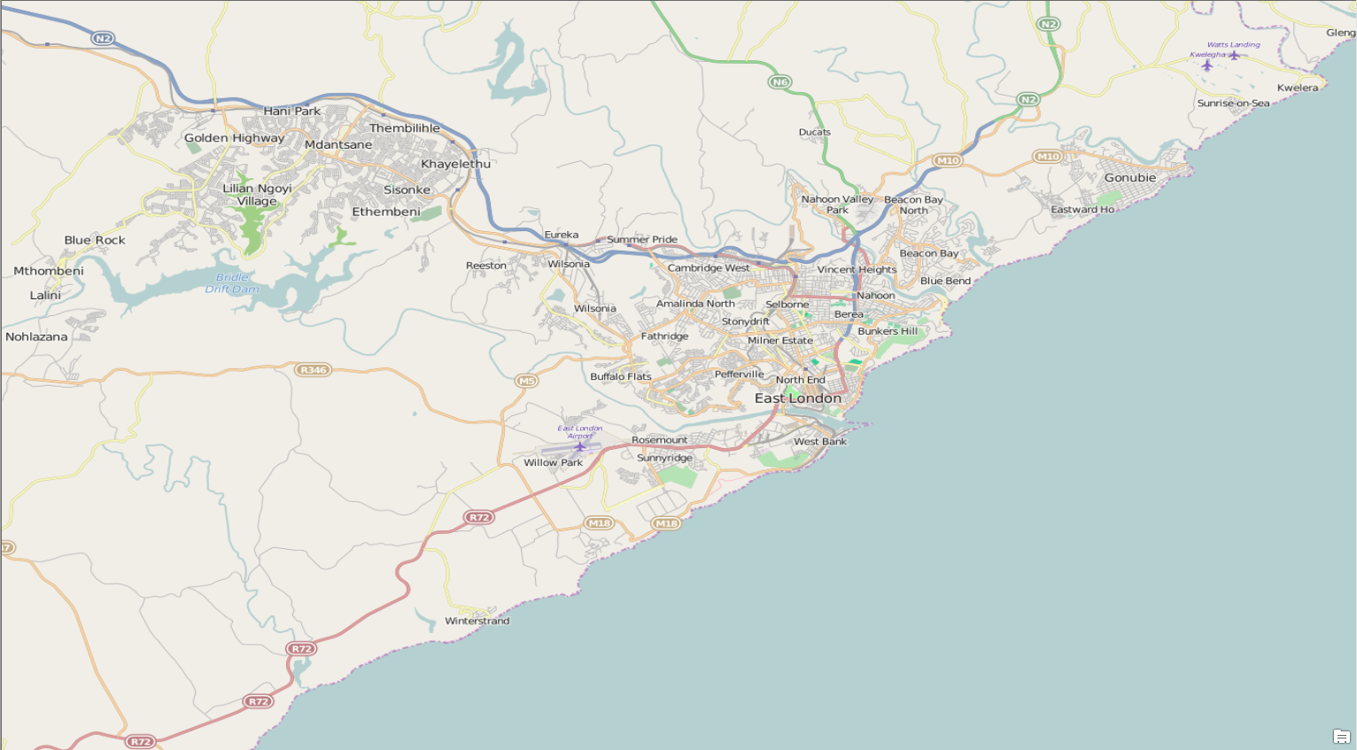
Practical implication - Urban roads programme
Upgrading of roads, adding 1 lane in both directions
( 1.5km)
CBD Resealing of Roads 1.2km
Maintenance of roads, coastal 4.2km
Repair section of Stormwater (110m)

Slide 8
Challenge
Each project represents a different spatial entity
The programme includes 3 capital and two maintenance projects
The capital programmes represent 3 different types of capital expenditure
The maintenance projects deal with two different types of asset groups

Slide 9
Current reality
Programme (IDP/MTREF) | Project name | Expenditure type | Link to asset register
Urban Roads Programme | Resealing of roads - 1.2km | Renewal
 | Upgrading of roads: adding 1 lane in each direction - 900m | Upgrading
 | Maintenance of roads: pothole repairs - CBD - 3.5km | Maintenance
 | Repair section of stormwater - 110m | Maintenance
 | New access road - 600m | New
Currently, expenditure on programmes are often aggregated under a single line item in the capital expenditure section of the general ledger and segregation between projects, and often capital and maintenance, is impossible without analysing the technical documents (BOQ’s; as built plans, etc.).
Programmes can be multifaceted, but projects should clearly identify portions that are of different lifestyle treatment (can be separate portions and projects)

Slide 10
SCOA allocation
Programme (IDP/MTREF) | Project name | Expenditure type | Classification as per SCOA Project Segment |  |  |  |  |  | Link to asset register Asset Sub-class
 |  |  | 1 | 2 | 3 | 4 | 5 | 6
Urban Roads Programme | Resealing of roads - 1.2km | Renewal | Capital | Infrastructure | Existing | Rehabilitation and Refurbishment | Urban Roads Prgramme_Renewal_Roads_01 |  | Roads, Bridges and Storm Water
 | Upgrading of roads: adding 1 lane in each direction - 900m | Upgrading | Capital | Infrastructure | Existing | Upgrade and Additions | Urban Roads Prgramme_Upgrade_Roads_02 |  | Roads, Bridges and Storm Water
 | Maintenance of roads: pothole repairs - CBD - 3.5km | Maintenance | Operational | Maintenance and Repair | Infrastructure | Roads, Pavements, Bridges and Storm Water | Planned | Urban Roads Prgramme_Main-tenance_Roads_03 | Roads, Bridges and Storm Water
 | Repair section of stormwater - 110m | Maintenance | Operational | Maintenance and Repair | Infrastructure | Roads, Pavements, Bridges and Storm Water | Planned | Urban Roads Prgramme_Main-tenance_Stormwater_04 | Roads, Bridges and Storm Water
 | New access road - 600m | New | Capital | Infrastructure | New | Roads, Pavements, Bridges and Storm Water | Urban Roads Prgramme_New_ Roads_05 |  | Roads, Bridges and Storm Water

Slide 11
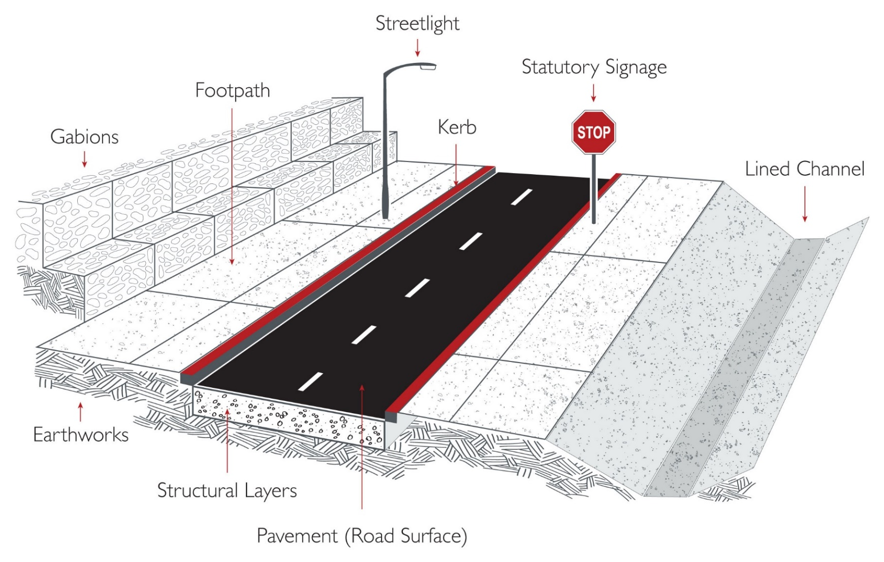
Current reality
Component | EUL
Earthworks | 100
Road structural layer | 80
Road surface | 15
Road marking | 4
Kerb | 50
Street light | 45
Sign - regulatory | 7
Kerb Inlet | 20
Pipe - stormwater | 50
Total | 34

Slide 12
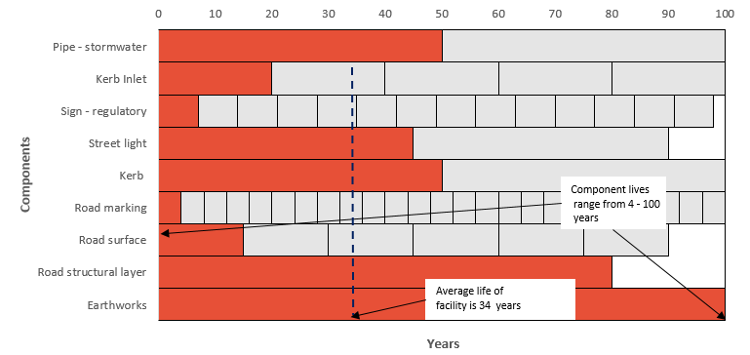
Current reality

Slide 13
Ideal situation
Programme (IDP/MTREF) | Project name | Expenditure type | Existing SCOA Classification | Link to asset register
 |  |  |  | Asset Sub-class | (7) Asset group type | (8) Asset Type | (9) Asset component type | Component number
Urban Roads Programme | Resealing of roads - 1.2km | Renewal |  | Roads, Bridges and Storm Water | Road | Pavement | Road surface | RdS_1002
 | Upgrading of roads: adding 1 lane in each direction - 900m | Upgrading |  | Roads, Bridges and Storm Water | Road | Pavement | Road surface | RdS_1058
 |  |  |  |  |  |  | Road structural layer | RdS_1059
 |  |  |  |  |  | Earthworks | Earthworks | Rde_1160
 |  |  |  |  | Road Furniture | Road Furniture | Road marking | Rdf_794
 |  |  |  |  |  |  | Sign - regulatory | Rdf_795
 |  |  |  |  |  |  | Street light | Rdf_796
 |  |  |  |  | Stormwater | Drainage | Kerb | Swd_349
 |  |  |  |  |  |  | Channel | Swd_350
 |  |  |  |  |  | Pipe work | Pipe - Storm Water | Swp_1671
 | Maintenance of roads: pothole repairs - CBD - 3.5km | Maintenance |  | Roads, Bridges and Storm Water | Road | Pavement | Road surface | Rds_019
 |  |  |  |  |  |  | Road structural layer | Rds_022
 | Repair section of stormwater - 110m | Maintenance |  | Roads, Bridges and Storm Water | Stormwater | Civil structure | Erosion protection | Swc_241
 |  |  |  |  |  |  | Masonry structure | Swc_250
 |  |  |  |  |  | Pipe work | Pipe - Storm Water | Swp_492
 | New access road - 600m | New |  | Roads, Bridges and Storm Water | Road | Pavement | Road surface | Rds_1163
 |  |  |  |  |  |  | Road structural layer | Rds_1164
 |  |  |  |  |  | Earthworks | Earthworks | Rde_1195
 |  |  |  |  | Road Furniture | Road Furniture | Road marking | Rdf_801
 |  |  |  |  |  |  | Sign - regulatory | Rdf_802
 |  |  |  |  |  |  | Street light | Rdf_803
 |  |  |  |  | Stormwater | Drainage | Kerb | Swd_421
 |  |  |  |  |  |  | Channel | Swd_422
 |  |  |  |  |  | Pipe work | Pipe - Storm Water | Swp_1690

Slide 14
Ideal situation
IDP
Links to MTREF with programme name
MTREF
Links from IDP
FAR
Links from Project segment
Project segment
Links from MTREF
Links to programme name and Project segment with project name, nature of expenditure and asset component
Links to FAR at component level
Automatically aligns with IDP and MTREF
SCOA currently aligns the project segment and the asset register at the asset sub-class level (water and electricity projects excluded), but makes provision for additional breakdowns on both capital and maintenance expenditure.
Component level budgeting automatic aligns the IDP, MTREF, FAR and financial record

Slide 15
NERSA and DWA
SCOA includes and additional classification level for electricity, water and sanitation infrastructure based on reporting requirements as provided by NERSA and DWA
Ideally, asset creation is planned and budgeted for based on a management and functional alignment principle (per discipline) and not at an expenditure level. (As an example, one would not budget for asset types such as poles and then attempt to determine how many pole mounted transformers can be installed)
These groupings are fundamental to the management and maintenance of these assets, and budgeting must take place at this level if alignment with business processes (including maintenance regimes and lifecycle strategies) and the IDP is to be achieved.
Significant differences between lifecycles of components which are brought together into a functional asset type, makes the application of a consistent component level hierarchy essential to enable meaningful comparisons, status reporting and lifecycle strategies.
The applied hierarchy should also be consistent across all asset types. When the NERSA and DWA hierarchies as embedded within SCOA is measured against this principle , it is clear that:
These classifications contain elements of asset group types, asset types and component

Slide 16
NERSA and DWA
NERSA Classification |  | Asset group type | Asset type | Compo-nent type
Electricity | Automated/Prepaid Meters
 | Buildings, Fixtures and Improvements
 | Conventional Meters
 | Leasehold Improvements
 | Leased Property on Customer Premises
 | Other Installation on Customers Premises
 | Overhead Conductors and Devices
 | Poles, Towers and Fixtures
 | Storage Battery and Equipment
 | Street Lighting and Signal Systems
 | System Communication and Control
 | Transformer Station Equipment - Normally Primary above 132kv
 | Transformer Station Equipment - Normally Primary below 132kv
 | Underground Conduit
 | Underground Conductor Devices
DWA Classification |  | Asset group type | Asset type | Compo-nent type
Water | Water: Dams
 | Water: Springs
 | Water: Weirs
 | Water: Boreholes
 | Water: Reservoirs
 | Water: Civil Works
 | Water: Mechanical Works
 | Water: Electrical Works
 | Water: Pump Station Civil Works
 | Water: Pump Station Mechanical Works
 | Water: Pump Station Electrical Works
 | Water: Internal Water Reticulation
 | Water: Bulk Water Reticulation:
 | Water: Meters Bulk
 | Water: Meters Household

Slide 17
Thank you

Slide 18
Definitions used for asset activities
Maintenance – International definition (IIMM):
“All actions necessary for retaining an asset in as near as practicable to its original condition, but excluding rehabilitation or renewal. Maintenance does not increase the service potential of the asset or keep it in its original condition – it slows down deterioration and delays when rehabilitation or replacement is necessary.”
This definition is consistent with accounting standards, and would lead to maintenance expenditure being expensed.

Slide 19
Definitions used for asset activities
Maintenance – SCOA provides several definitions of maintenance and repair:
“All actions which have the objective of retaining an item in or to a state in which it can perform its required function” – SCOA Section 5, Clause 369, pg. 134.
“Includes activities aimed at maintaining the capacity and effectiveness of an asset at its intended level. The maintenance action implies that the asset is restored to its original condition and that there is no significant enhancement to its capacity, or to the value of the asset” – SCOA Section 5, Clause 373, pg. 134.
The latter definition contradicts both the accounting treatment principle and the international definition, and is internally inconsistent (as well as with the 1st definition provided in Clause 36).
Restoring the asset to its original condition would imply returning it to an as-new state. This would extend the number of years over which the asset would prove beneficial, which additional value must be reflected in the balance sheet.

Slide 20
Definitions used for asset activities
RENEWAL
RENEWAL & UPGRADING

Slide 21
Definitions used for asset activities
Rehabilitation or refurbishment – International definition:
Works to rebuild or replace parts or components of an asset, to repair it to a required functional condition and extend its life, which may involve some modification. It generally involves repairing the asset to a state where it is able to deliver its original intended level of service, without resorting to significant upgrading or renewal.
Notes:
The rules of accounting dictate that since asset life is extended (assuming beyond the financial period in which that expenditure is incurred in), the expense must be capitalised.
Rehabilitation or refurbishment is an antiquated, contradictory term in that it states that “part or components of an asset”. Since separately recognised components are registered as assets in their own right, capital intervention of this nature constitutes renewals. However, in the way the definition reads, if one ignores the portion of extension of asset life and use of the term “repair”, the intervention can be either of a capital nature or repairs, that is a form of maintenance that should be expensed.
SCOA definition of rehabilitation and refurbishment
Activities that are required due to neglect or unsatisfactory maintenance or degeneration of an asset – SCOA Section 5, Clause 332, pg. 127 and Clause 347, pg. 130.
This is not an useful definition, as it neither specifies the nature of the asset lifecycle activity or intervention required to address the current undesired state of the asset nor the result of the rehabilitation effort to be undertaken.

Slide 22
Definitions used for asset activities
SCOA clauses 335, 341 and 342 (Section 5, pgs 128-129) attempt to clarify rehabilitation or refurbishment by providing more comprehensive explanations:
Clause 335 – refers to rehabilitation in the context of existing infrastructure
“Activities that are required due to neglect or unsatisfactory maintenance or degeneration of an asset. The action implies that the asset is restored to its original condition, enhancing the capacity and value of an existing asset that has become inoperative due to the deterioration of the asset. The Budget Reporting Format refers to refurbishment/maintenance to an asset that will restore or maintain the originally assessed future economic benefits or service potential that an entity can expect from an asset and is necessary for the planned life to be achieved.
Notes:
Refurbishment and maintenance should not be mixed in one definition.
The definition is either internally inconsistent, or an inappropriate reference was made to the Budget Reporting Format, or that latter Format is incorrect, or both are out of kilter, since:
“Restoring an asset to its original condition” implies renewal, that focusses on asset condition and life.
“Enhancing the capacity” of the asset is neither rehabilitation/refurbishment nor renewals, and is not in and of itself an appropriate response to “neglect or unsatisfactory maintenance or degeneration of an asset” – enhancement involves improving the capacity and/or effectiveness of the asset beyond its original intended purpose (Clause 340, pg 129).
The Budget Reporting Format limits refurbishment to maintaining the originally assessed future economic benefits, which equates to restoring the asset to its original condition, which is renewal, but not upgrading.
SCOA clauses 335, 341 and 342 (Section 5, pgs 128-129) attempt to clarify rehabilitation or refurbishment by providing more comprehensive explanations:
Clause 335 – refers to rehabilitation in the context of existing infrastructure
“Activities that are required due to neglect or unsatisfactory maintenance or degeneration of an asset. The action implies that the asset is restored to its original condition, enhancing the capacity and value of an existing asset that has become inoperative due to the deterioration of the asset. The Budget Reporting Format refers to refurbishment/maintenance to an asset that will restore or maintain the originally assessed future economic benefits or service potential that an entity can expect from an asset and is necessary for the planned life to be achieved.
Notes:
Refurbishment and maintenance should not be mixed in one definition.
The definition is either internally inconsistent, or an inappropriate reference was made to the Budget Reporting Format, or that latter Format is incorrect, or both are out of kilter, since:
“Restoring an asset to its original condition” implies renewal, that focusses on asset condition and life.
“Enhancing the capacity” of the asset is neither rehabilitation/refurbishment nor renewals, and is not in and of itself an appropriate response to “neglect or unsatisfactory maintenance or degeneration of an asset” – enhancement involves improving the capacity and/or effectiveness of the asset beyond its original intended purpose (Clause 340, pg 129).
The Budget Reporting Format limits refurbishment to maintaining the originally assessed future economic benefits, which equates to restoring the asset to its original condition, which is renewal, but not upgrading.

Slide 23
Definitions used for asset activities
A
Asset
A resource owned or controlled by an entity as a result of past events and from which future economic benefits or service potential are expected to flow to the entity.
Asset hierarchy
A framework for segmenting an asset base into appropriate classifications. The asset hierarchy can be based on asset function; asset type or a combination of the two.
Asset life
Period from asset creation to asset end-of-life.

Slide 24
Definitions used for asset activities
A - C
Asset register
A record of asset information considered worthy of separate identification for both asset accounting and management purposes including inventory, historical, financial, condition and construction, technical and financial information about each.
Note: The unit of account in an asset register is a component (see definition of a component).
Capacity
Maximum output that can be produced or delivered using existing network or infrastructure.
Capital expenditure
Expenditure used to create new assets, increase the capacity of existing assets beyond their original design capacity or service potential, or to returns the service potential of the asset or expected useful life of the asset to that which it had originally. CAPEX increases the value of capital asset stock.
Capital upgrading
Enhances the service potential of the asset or the economic benefits that can be obtained from use of the asset and may also increase the life of the asset beyond that initially expected.

Slide 25
Definitions used for asset activities
C - D
Component (IIMM)
A component ^{(Note 1)} is a specific part of a complex item ^{(Note 2)} that has independent physical or functional identity and specific attributes such as different life expectancy, maintenance and renewal requirements and regimes, risk or criticality.
Note 1: A component is separately recognised and measured (valued) in the organisation's asset register as an unique asset record, in accordance with the requirements of GRAP 17 to componentise assets.
Note 2: A complex item is one that can be disaggregated into significant components. Infrastructure and buildings are considered complex items.
Condition (IIMM)
The physical state of the asset.
Corrective maintenance
Maintenance carried out after a failure has occurred and intended to restore an item to a state in which it can perform its required function. Corrective maintenance can be planned or unplanned.
Decommissioning (IIMM)
Actions required to take an asset out of service.

Slide 26
Definitions used for asset activities
D – F
Deferred Maintenance
The portion of planned maintenance work necessary to maintain the service potential of an asset that has not been undertaken in the period in which such work was scheduled to be undertaken.
Disposal (IIMM)
Actions necessary to decommission and dispose of assets that are no longer required.
Economic life (IIMM)
The period from the acquisition of the asset to the time when the asset, while physically able to provide a service, ceases to be the lowest cost alternative to satisfy a particular level of service. The economic life is at the maximum when equal to the physical life, however obsolescence will often ensure that the economic life is less than the physical life.
Facility (IIMM)
A complex comprising many assets (e.g. a hospital, water treatment plant, recreation complex, etc.) which represents a single management unit for financial, operational, maintenance or other purposes.

Slide 27
Definitions used for asset activities
L
Life (LGIAMG)
A measure of the anticipated life of an asset or component; such as time, number of cycles, distance intervals etc.
Infrastructure assets (LGIAMG)
Stationary systems forming a network and serving whole communities, where the system as a whole is intended to be maintained indefinitely at a particular level of service potential by the continuing replacement and refurbishment of its components.
Level of service (IIMM)
Levels of service statements describe the outputs or objectives an organisation or activity intends to deliver to customers.
Lifecycle (IIMM)
The time interval that commences with the identification of the need for an asset and terminates with the decommissioning of the asset or any liabilities thereafter.

Slide 28
Definitions used for asset activities
M
Maintenance
All actions, planned and unplanned, intended to ensure that an asset performs a required function to a specific performance standard(s) over its expected useful life by keeping it in as near as practicable to its original condition, including regular recurring activities to keep the asset operating, but specifically excluding renewal.
Note: Maintenance also specifically excludes restoring the condition or performance of an asset following a recognised impairment event, which would be classified as either renewal or upgrading, depending on the circumstances.
Maintenance expenditure
Recurrent expenditure as required to ensure that the asset achieves its intended useful life. Maintenance is funded through the organisation’s operating budget, and such expenditure is expensed in the organisation’s Statement of Financial Performance.
Maintenance objectives (IIMM)
Objectives for what maintenance has to achieve to ensure the assets are in the right condition to meet the needs of the organisation. Maintenance performance measures and targets are the means of assessing whether the maintenance objectives are being met.

Slide 29
Definitions used for asset activities
M - P
Maintenance standards (LGIAMG)
The standards set for the maintenance service, usually contained in preventive maintenance schedules, operation and maintenance manuals, codes of practice, estimating criteria, statutory regulations and mandatory requirements, in accordance with maintenance quality objectives.
Maintenance strategy (IIMM)
Identifies the tactics and tools that will be used to deliver the maintenance plan, as well as defining the maintenance roles and responsibilities.
Obsolescence (Optimised Decision-Making Guidelines)
The asset can no longer be maintained, or suffers a loss in value due to a decrease in the usefulness of the asset, caused by technological change, or changes in people's behavioural patterns or tastes, or environmental changes.
Preventative maintenance
Maintenance carried out at pre-determined intervals, or corresponding to prescribed criteria, and intended to reduce the probability of failure or the performance degradation of an item. Preventative maintenance is planned or carried out on opportunity.

Slide 30
Definitions used for asset activities
R
Remaining useful life (IIMM)
The time remaining until an asset ceases to provide the required service level or economic usefulness.
Renewal
Expenditure on an existing asset which returns the service potential of the asset or expected useful life of the asset to that which it had originally
Note 1: Renewal can include works to replace existing assets or facilities with assets or facilities of equivalent capacity or performance capability.
Note 2: Expenditure on renewals is funded through the organisation’s capital budget, and such expenditure is recognised in the organisation’s Statement of Financial Position.
Routine maintenance (IIMM)
Day to day operational activities to keep the asset operating (replacement of light bulbs, cleaning of drains, repairing leaks, etc.) and which form part of the annual operating budget, including preventative and periodic maintenance.

Slide 31
Definitions used for asset activities
U
Unplanned maintenance (IIMM)
Corrective work required in the short term to restore an asset to working condition so that it can continue to deliver the required service or to maintain its level of security and integrity.
Useful life (GRAP)
The useful life of an asset is the period over which an asset is expected to be available for use by an entity or the number of production or similar units expected to be obtained from the asset by an entity.
Erase the following terms:
Rehabilitation
Refurbishment

